Slide 1


Family Connect

Slide 2
Aims of the session
Introductions (2 minutes from each person if they feel comfortable)
Group Agreement
Talking to your child / young person about their diagnosis
Local Support
Accessing other support like advice in re education
Questions from parent carers
Feedback

Slide 3









Hand Up function
Use chat function
Notes:
Technology – using chat/ hands up
Interruptions (cats/children etc.)
Mobiles –
Confidentiality – Stays within the group. If we hear any concerns we would discuss with you
Toilets –
Break – We have a break around half way through
Agreement to listen to others –
Any others? Group can decide

Slide 4
Group Agreement
Teams controls
You can leave at any point if you need to.
Let everyone have an opportunity to share, if they want to.
It’s ok to not be ok.
Confidentiality
Links will be sent by email after the session that we discuss.
Please send us some feedback after the session, it helps us to make sure we are offering you the right information and that more families can access these sessions.

Slide 5
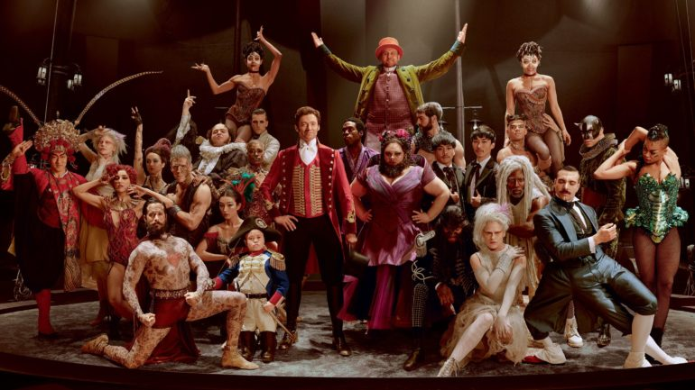
This is ME!
For young people in years 7-9 at secondary school (11-14yr old’s) WITH a diagnosis of Autism.
Currently being delivered online but will offer option of face to face / virtual when COVID restrictions allow and depends on group needs.
4 young people per group.
4 sessions with 2 members of the ASD Assessment team after school.
Young person must want to engage and express that.
Sessions used to promote positive self esteem, confidence and a focus on individuals strengths.
Recognising commonalities within the group
Using positive role models to identify with
Focus on what can be achieved using their strengths.
Referral via LD referral form – contact the LD and Autism team 01524 550331 / LMChildAutism@lscft.nhs.uk

Slide 6



Other inspirational Neurodiverse people

Slide 7






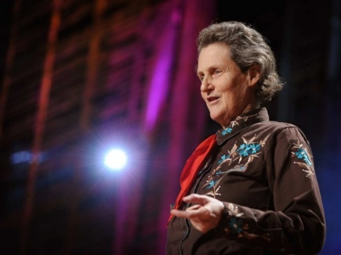
Famous Autistic People
Dan Aykroyd – Comedic Actor
Hans Christian Andersen – Children’s Author
Susan Boyle – Singer
Tim Burton – Movie Director
Lewis Carroll – Author of “Alice in Wonderland”
Charles Darwin – Naturalist, Geologist, and Biologist
Emily Dickinson – Poet
Albert Einstein – Scientist & Mathematician
Bobby Fischer – Chess Grandmaster
Bill Gates – Co-founder of the Microsoft Corporation
Temple Grandin – Animal Scientist
Daryl Hannah – Actress & Environmental Activist
Steve Jobs – Former CEO of Apple
Michelangelo – Sculptor, Painter, Architect, Poet
Wolfgang Amadeus Mozart – Classical Composer
Sir Isaac Newton – Mathematician, Astronomer, & Physicist
Anthony Hopkins - Actor
Satoshi Tajiri – Creator of Nintendo’s Pokémon
Nikola Tesla – Inventor
Andy Warhol – Artist
Anne Hegerty – The Chase
Greta Thunberg – Activist
Lucy Bronze – Women’s Footballer

Slide 8
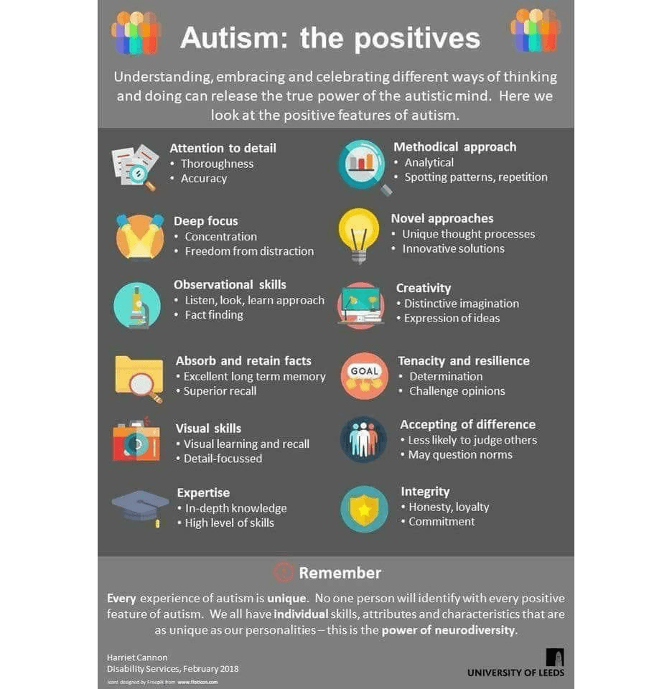
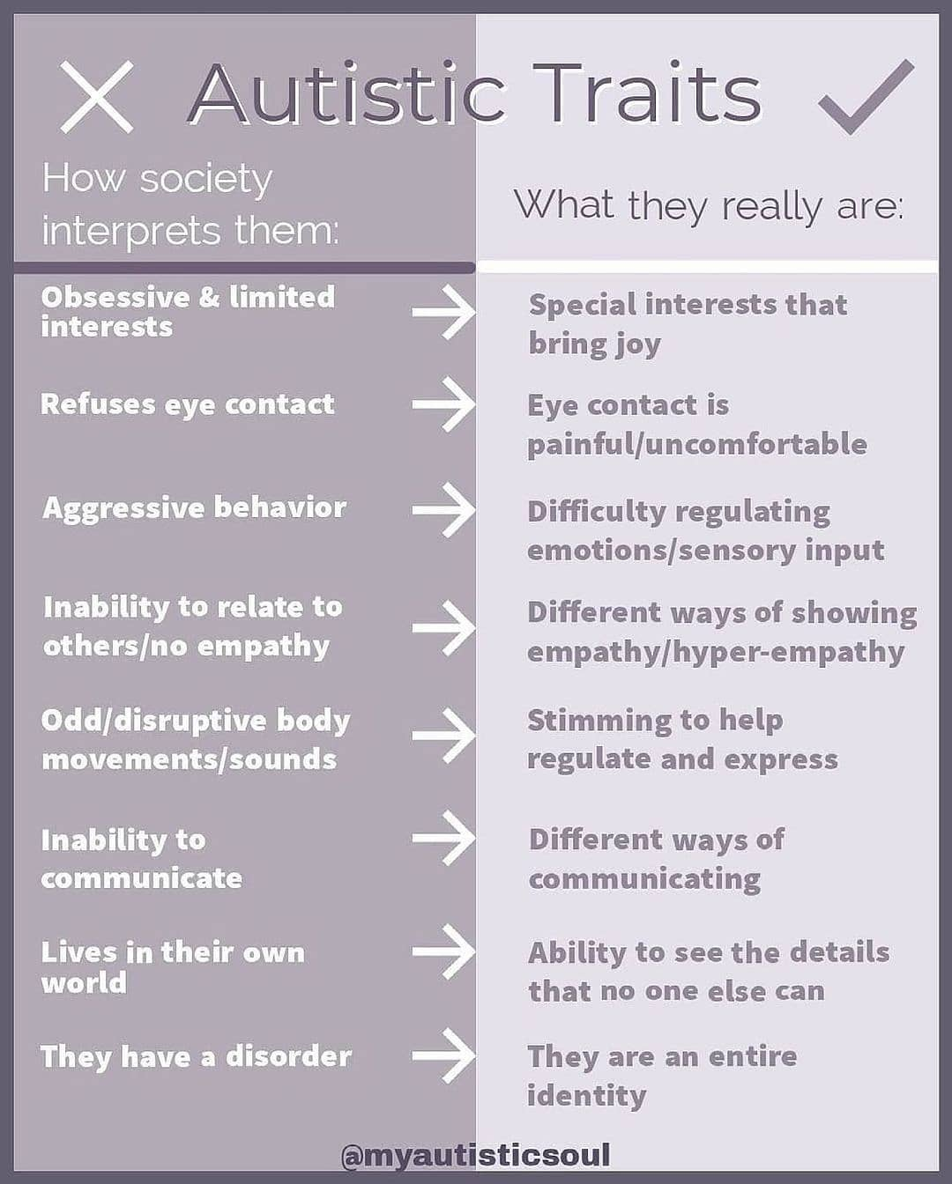

Slide 9


Resources to support understanding of the diagnosis
www.autism.org.uk/advice-and-guidance/topics/resources-for-autistic-teenagers
The Know Yourself series is a set of free resources which includes videos and downloadable guides aiming to support you and others like you to understand what being autistic means.
In the resources you'll hear from young autistic people talking about their experiences and what has helped them. The aim is to offer information and ideas that will empower you to begin to explore your own experiences and understand yourself more.
The series will cover six topics in total over the course of three years. First 2 are below
Energy Accounting Guide (Similar to Spoon theory)
National Autistic Society Know Yourself series (thirdlight.com)
Know Yourself Guide – list of resources including booked and videos to support understanding
Know Yourself other resources.pdf (thirdlight.com)
www.autism.org.uk/advice-and-guidance/topics/diagnosis Information, practical and multimedia resources about how autistic people and their families may feel after a diagnosis and the support that may be available.
What is Autism videos and resources
www.ambitiousaboutautism.org.uk/information-about-autism/understanding-autism/what-is-autism
Some new resources have been launched on the Ambitious about Autism website to support understanding behaviour. Quality of life at home toolkit | Ambitious about Autism

Slide 10

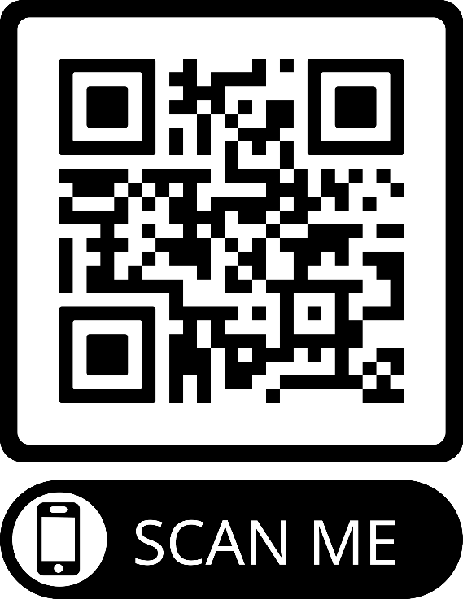





www.autism.org.uk/advice-and-guidance/topics/resources-for-autistic-teenagers

Slide 11
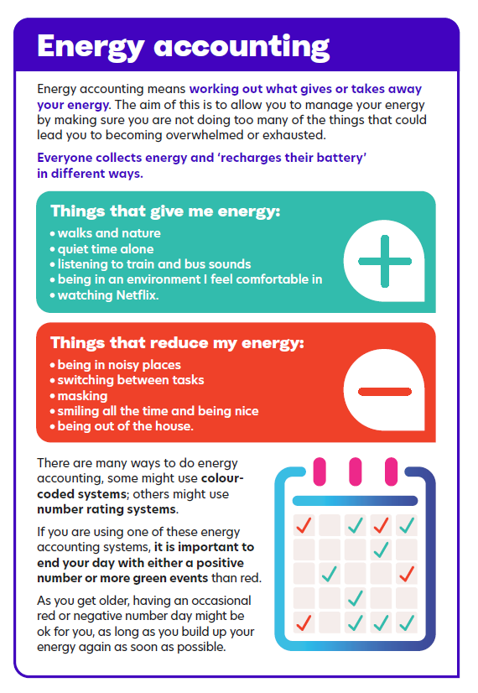
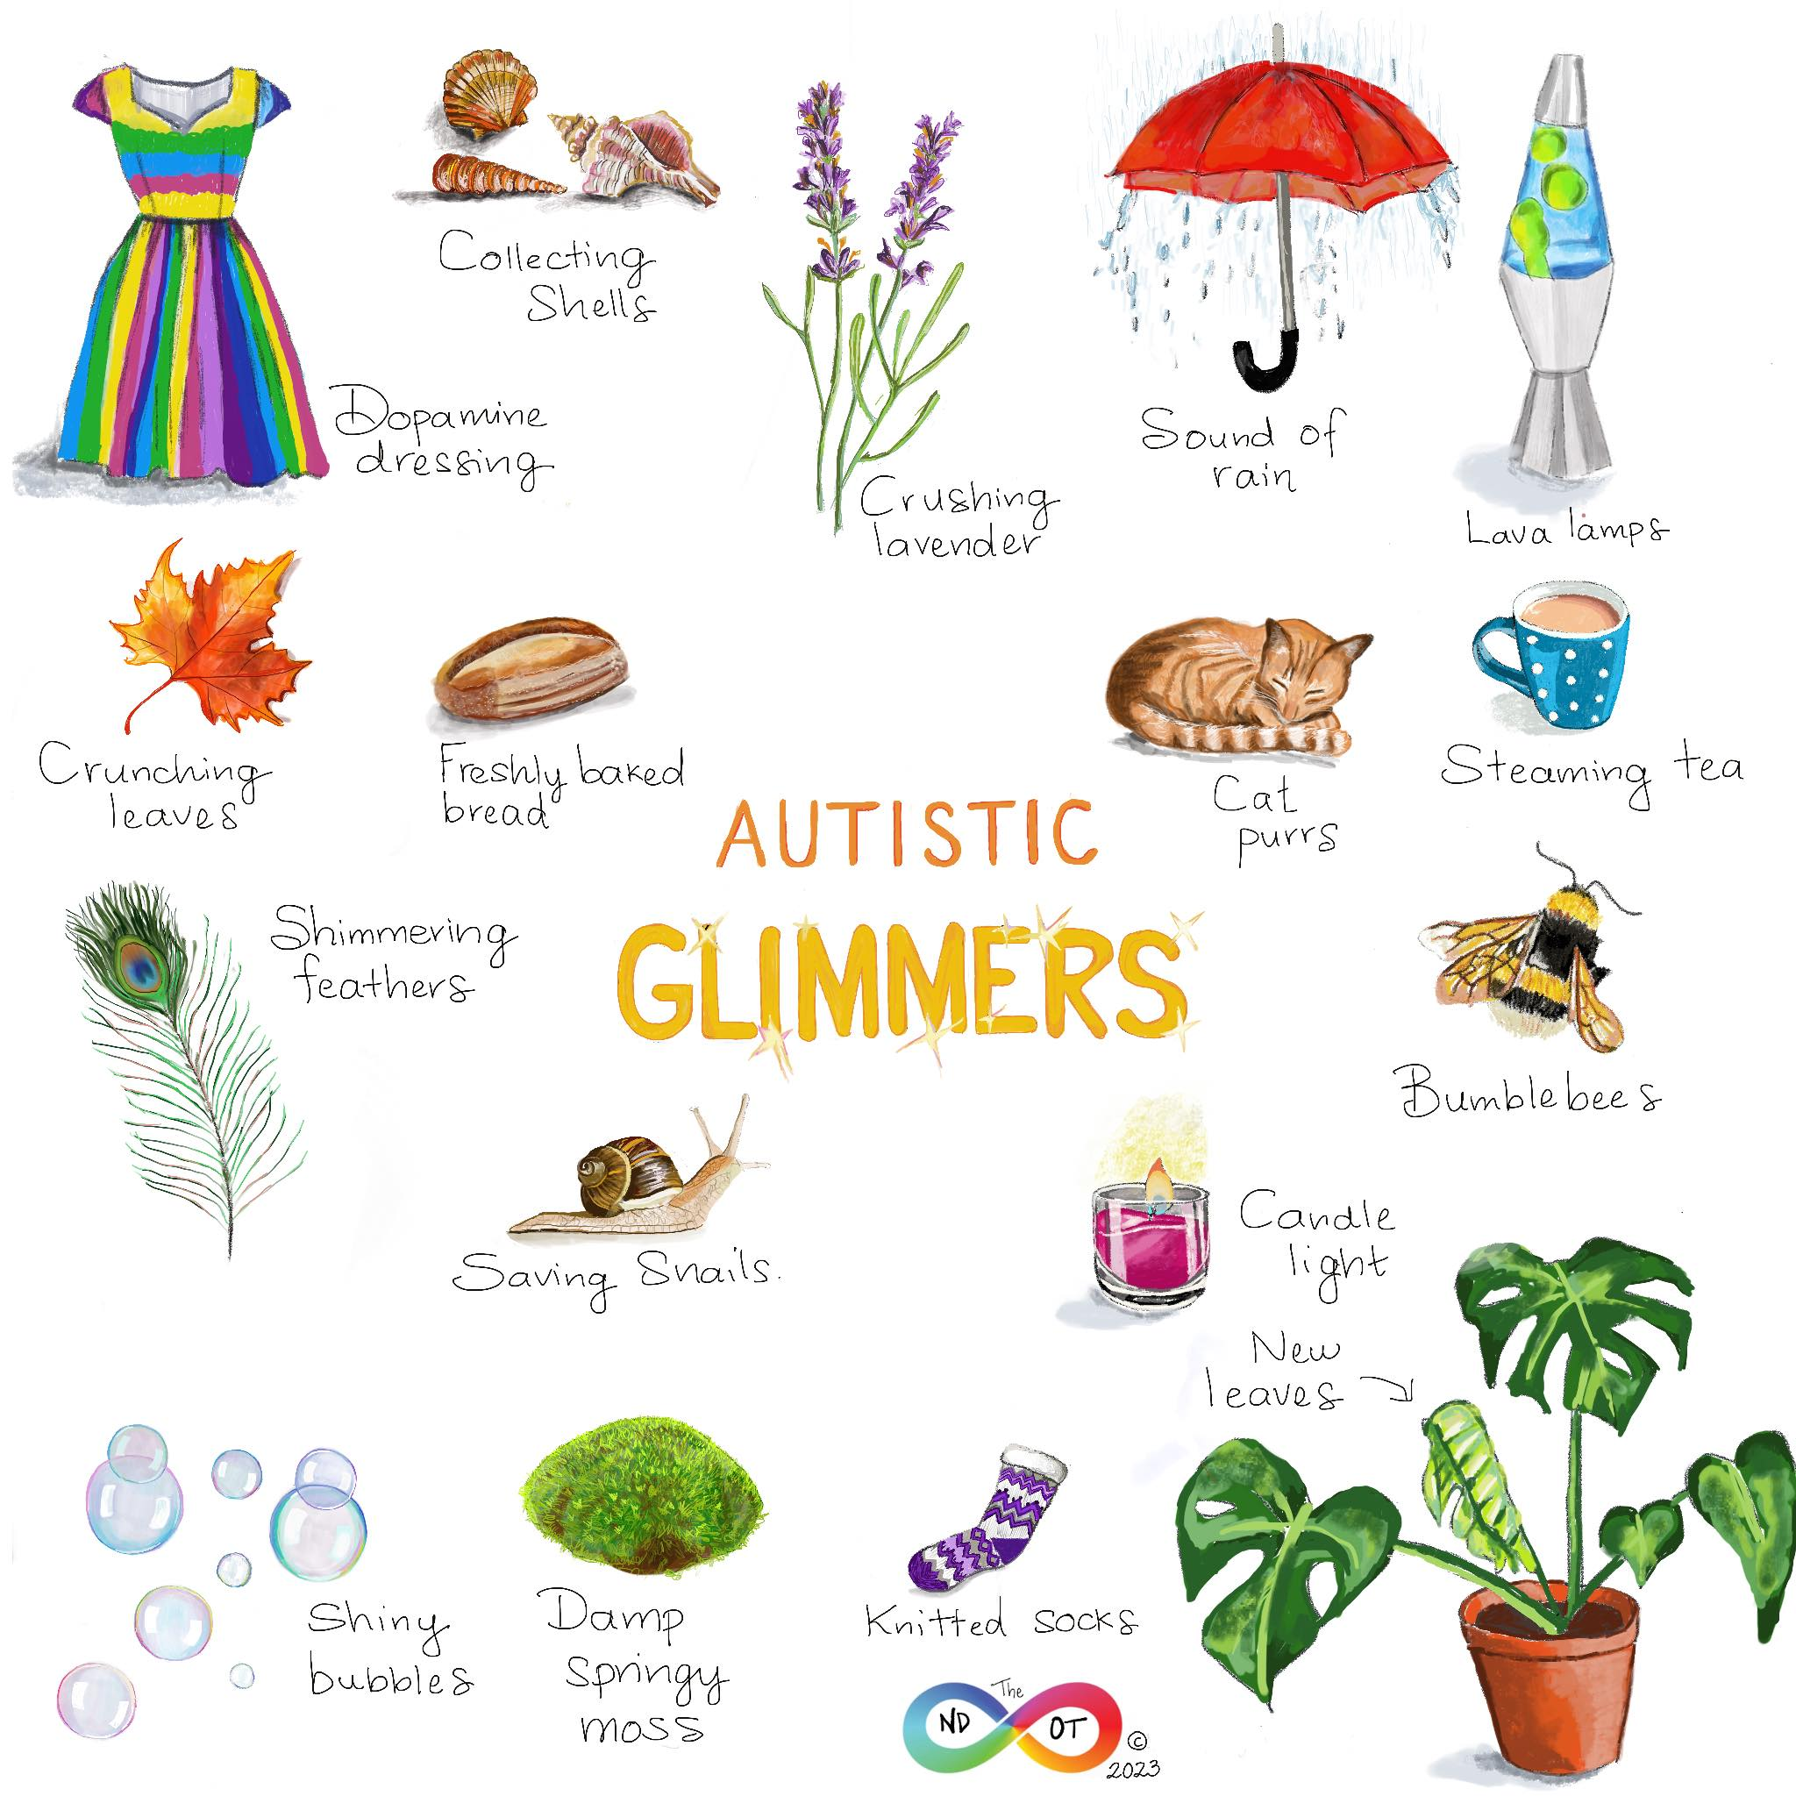

Slide 12
Check your pack of resources that was sent to you with the Diagnosis report for useful links including:
‘Amazing things happen’ you tube clip about ASD
https://www.youtube.com/watch?v=RbwRrVw-CRo
Please see link below for an excellent new video about autism from the Autism Education trust , I would recommend this from primary aged 7+
www.autismeducationtrust.org.uk/celebrating-autistic-strengths-and-differences
Inside our Autistic Minds BBC Two - Inside Our Autistic Minds
Paddy McGuinness documentary – Our Family and Autism
https://www.bbc.co.uk/iplayer/episode/m00122vl/paddy-and-christine-mcguinness-our-family-and-autism
Discover together what brings them JOY! As long as it’s safe and can be done in a safe and responsible way, let them continue with their passion. We all have things that make us happy and brings us joy. Encourage them to try new things or revisit old passions to find their “thing”.

Slide 13

Lancashire and South Cumbria Thrive Service
01772 505138 thrivelsc@barnardos.org.uk
www.barnardos.org.uk/get-support/services/lancashire-and-south-cumbria-thrive-service
The service offers therapeutic one-to-one, group work and counselling support to children and young people aged 5 to 18 (extending to 25 years based on SEN need) within the whole of the Lancashire & South Cumbria Integrated Care Board (ICB) area.
Please note: The My Time to THRIVE Service is NOT a crisis service. We provide support to children & young people with low – moderate mental health needs. Services supporting children and young people's emotional health and wellbeing. We have centres where children and young people can visit and have a trained worker they can trust and talk to. We help them build their confidence and get to the root of their difficulties.
If you need urgent support, please contact your GP, the local CAMHS Crisis Team (via 0800 953 0110) or in an emergency situation, you should consider contacting Emergency Services or visit your local A&E department or Urgent Care facility.
Here are some other services and organisations, that may also be useful to you:
www.kooth.com
www.youngminds.org.uk
www.every-life-matters.org.uk

Slide 14

Lancashire Mind Peer Support Programme
www.lancashiremind.org.uk/project/childrens-peer-support/
North Lancashire Contact charlottesutton@lancashiremind.org.uk
Through innovative, peer-led support systems, this programme aims to enhance the mental health and wellbeing of young people aged 10 to 19 (up to 25 with SEND) across Lancashire. With children facing an alarming increase in mental health challenges, we can help support them to find coping strategies and build resilience.
Our Peer Support Programme is run across Lancashire. The project offers multiple routes for young people to access the support they need, tailored to their individual wellbeing needs. The key elements of the programme include wellbeing assessments, diverse support routes, and the training of community peer support mentors.
Support Available
The initiative addresses the growing prevalence of mental health issues among young people. We deliver a range of wellbeing provisions within the programme, including:
1:1 Peer Support Wellbeing Coaching (virtual sessions)
Support to access existing community groups
Signposting to specialist support
Peer support training
Establishing new groups for young people

Slide 15
Free Lancashire Mind course on Mental Health and neurodiversity called Supporting Your Child
Training for Parents
Supporting Your Child with emotional wellbeing and/or neurodiversity. A course for parents looking for tools and strategies to support the emotional health and wellbeing of their child.
www.trainingondemand.lancashiremind.org.uk
More information/video intro: https://www.youtube.com/watch?v=CXM2fnTiWhI
It is offered at no cost. It is for anyone interested in supporting mental wellbeing in their children but includes information specifically about mental wellbeing and neurodiversity (ADHD, autism, dyslexia and related mental differences). It has been created based on feedback from professionals, parents and those who are neurodivergent and/or who have had difficulties with their mental wellbeing.
There is a downloadable support kit at the end of the training full of practical ideas to support you and your child.
You can register and enrol here: https://trainingondemand.lancashiremind.org.uk/
Learning Objectives
Improve basic knowledge around neurodiversity
Understand the importance of mental health
Learn tools and techniques to support emotional wellbeing and self esteem
Recognition of the importance of communication and family cohesion
Disclaimer: This is not a specific mental health or neurodiverse diagnoses course. This is not a course for parents whose children or parents/carers who are in crisis. Both mental health and neurodiversity are broad spectrums of experience. This course is intended to provide parents and carers with tools and techniques to maintain communication and family cohesion, whilst navigating the challenges of parenting and the journey of seeking support. Difficult thoughts and feelings have intentionally been omitted to ensure that all our learners feel safe and supported throughout the session. For more information on our 'live' parenting workshops supported by trained facilitators, which do tackle more challenging topics, please contact training@lancashiremind.org.uk.
If your child is in crisis, please reach out to local NHS support by calling 999 for urgent support or contacting 111 (select 2) for non urgent support or speak to your GP.

Slide 16

www.pandasonline.org
NeuroBears (recommended by Anna Freud Organisation) is a course all about the autistic experience developed for, and in collaboration with, autistic young people. Aimed at young autistic people aged 8-14 who are new to understanding their autism. Through NeuroBears we hope to educate and increase young people’s understanding of their autistic experience and encourage them to share how they experience their autism with safe adults.
Neurobears has approximately 90 minutes of videos, broken down into 12 video sessions. The course is accompanied by young person and adult workbooks. License for home use is £75
The topics covered are:
A brief history of autism
A positive strengths-based diagnosis model. Autism Myths
Neurodivergence - Autism + environment = outcome
What autism isn’t – co-occurring conditions
Autism and sensory experience
Autistic overwhelm, meltdowns, and shutdowns. Autistic communication Autistic Masking. Spoon Theory and Autistic burnout. Autistic identity. Examples and personal experiences

Slide 17

www.lmc.ac.uk/courses/a-z-courses/understanding-autism-level-2
Understanding Autism - Level 2
Over the 8 - 12 weeks you will be required to complete a series of mandatory units.
Unit 1: Common traits and diagnosis of Autism Spectrum Disorder
This unit will provide you with an understanding of autistic spectrum conditions, the dyad of impairments and the importance of professional diagnosis of autism spectrum conditions. (Please note: This unit discusses Autism diagnosis using levels which is not something the NHS use in this area for diagnostic purposes)
Unit 2: Sources of information, support, legislation, and guidance relevant to Autism Spectrum Conditions
This unit covers the legislation and guidance relevant to autism spectrum conditions and helps you to understand ways to support individuals on the autism spectrum. This unit will also help you to understand the help and support available for individuals with autism spectrum disorder.
Unit 3: Living with Autism Spectrum Conditions
This unit covers the effect autism spectrum conditions have on an individual’s sensory experiences, the impact those conditions have on the family of an individual on the autism spectrum and the societal impact on individuals on the autism spectrum. This unit will also help you to understand the impact of the physical environment upon individuals on the autism spectrum.
Unit 4: Best practice relating to Autism Spectrum Conditions
This unit covers the experience of living with autism, how to support individuals to maintain their personal safety and the purpose of positive risk-taking. This unit will also help you to know how to support individuals with transitions, life events, accessing services and facilities and how to support individuals with employment.
On completion of this course you will receive a Level 2 Certificate in Understanding Autism, from TQUK.

Slide 18

www.beyondautism.org.uk/courses/an-introduction-to-autism-a-course-for-parents-families-and-carers/
Receiving a diagnosis of autism for a child, sibling or family member can be a confusing time. You may be seeking more information about what this means for the individual and their future. Or you may simply want to know how you can help.
This free course is designed to introduce what autism is, and provide information on key topics. This introductory course guides you through the full autism journey—from diagnosis, through transitions, and onto adulthood. Designed specifically for parents, families, and carers of autistic people, it covers essential topics such as communication, sensory needs, and behaviour, while also signposting you to valuable support networks.
With a completion time of approximately 2–4 hours, this course offers practical, useful insights into what autism means for individuals and their future.
For a range of downloadable resources go to the resource hub www.beyondautism.org.uk/resource-hub/

Slide 19

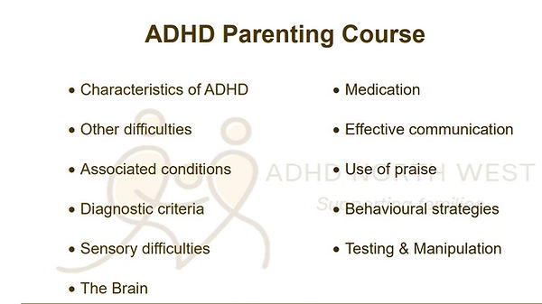
www.adhdnorthwest.org.uk
01254 886 886 reception@adhdnorthwest.org.uk
Online and 1:1 consultancy with parents to provide information, guidance, and Support. Our whole family approach is tailored to meet each family’s individually identified difficulties and needs. Advocacy and emotional support is often provided for school issues, case meetings, and clinic appointments. Parenting Programme is designed to meet the needs of parents of children who are diagnosed or in assessment for ADHD

Slide 20

Local Support
PARENT PEER SUPPORT
NLDG Facebook page for information https://www.facebook.com/NLDGAdditionalNeedsSupport/
NLDG Facebook group for advice on services and support from 900+ local families with children with various additional needs https://www.facebook.com/groups/NorthLancsDirectionsGroup
North Lancashire Local Offer and support needs information
www.northlancsdirectionsgroup.com website with links and support information for lots of additional needs diagnoses. Use the search function to look for information.
Parent peer support via CHATS group. (Carers. Help. Advisory. Training. Support) is a support group for parents / carers who have children or young people experiencing emotional or mental health difficulties. We run a virtual group via teams / zoom and a face to face session at More Music. The group was set up by parents in partnership with CAMHS for parents to get involved in helping develop children and young people’s mental health and be aware of services available. There is CAMHS worker on the virtual sessions to advise and guide parents. Email: for more details chatsnorthwest@gmail.com and for dates for the next meetings. CHATS Facebook group for parent peer support https://www.facebook.com/groups/598047137613422/.
Bee Unique variety of activities to choose from for all ages. With or without a diagnosis. Also run Monthly peer support groups in Lancaster and Morecambe. No booking necessary for the parent support group – details on the book when link. Booking essential for all other activities. www.bookwhen.com/beeunique

Slide 21
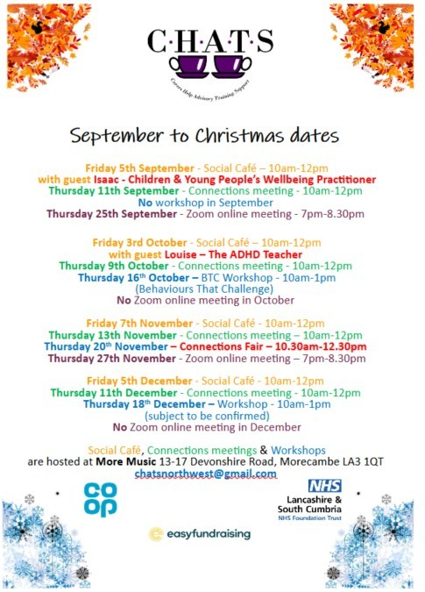
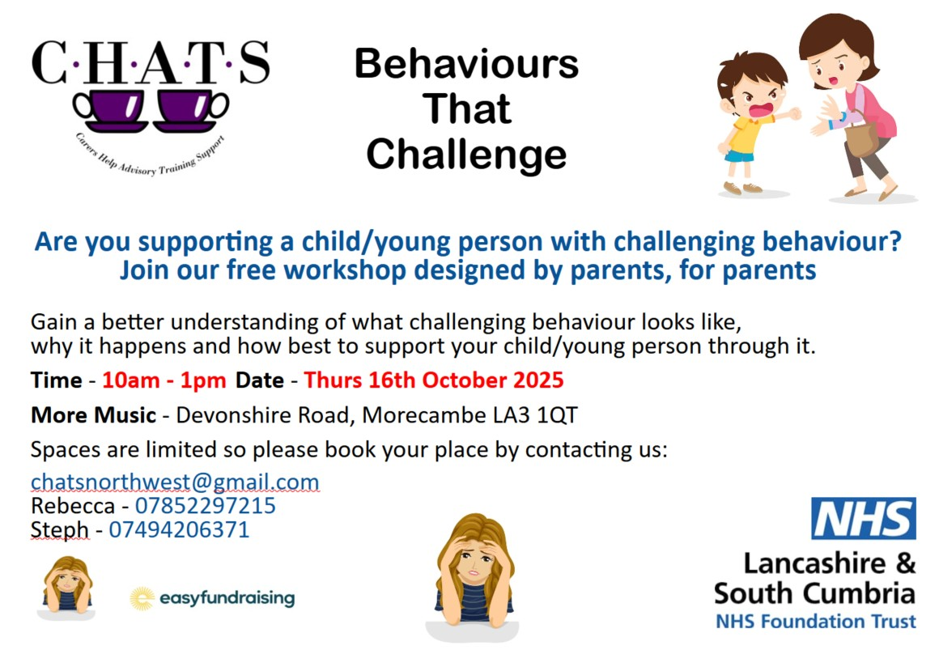

Slide 22
Local Providers for respite and groups.
Unique Kidz and Co http://www.uniquekidzandco.org.uk/
Term time and school holiday groups available. Monday – Friday after school club, Monthly Saturday Club, Siblings group, 4Ever Unique 16-25 Baking, arts and crafts, outdoor activities, sports, sensory activities, music etc 5-18 years 01524 831132
Mo Ro’s https://www.morecambe.lancsngfl.ac.uk/clubsandactivities/out-of-school-clubs/
Morecambe Road School, Monday – Friday 3:30pm – 5:30pm
Outdoor activities including trikes and bikes, adventure trail, playground games Indoor: film night, IT activities/gaming, arts and crafts, cookery, sensory equipment 4-16 years 01524 414384 or 07772 081042
Disability Friendly sessions at Jump Rush Thursdays 4.00-5.00 £6.00 per jumper (carer jumps for free) music turned down, fewer people booked in. www.jump-rush.com
Colourful Footsteps for parents of children with additional needs diagnosed or not, by Children and Family Wellbeing Service. Based at Lune Park Children’s Centre in Ryeland’s Park. Meets Thursday’s 1.00-2.30. Children under 8 welcome. Siblings welcome term time. No diagnosis needed. Phone 01524 581280 for details.
X Height at Salt Ayre Thursday evenings and Sunday afternoons Additional Needs Sessions - Lancaster City Council

Slide 23

Break Time registrations will reopen on in October Half Term!
Break Time provides fun group activities for children and young people aged 4-18 with SEND. In order to access the service, parents and carers must register EVERY YEAR. So if your child is already a member, or if you would like them to join, make sure you complete the form once it opens.
More information including the eligibility criteria and the registration form (once open) can be found on the Local offer website. Google search: Lancashire Local Offer Break Time

Slide 24
Groups for Young people aged 13+
A Spectrum Connection: Young person’s peer support group (16+) meets in Morecambe and Lancaster https://www.facebook.com/groups/aspectrumconnection aspectrumconnection@aol.com
Spectrum Gaming Facebook page https://www.facebook.com/Spectrum0Gaming
Ambitious Youth Network for autistic young people aged 16-25 Join the Ambitious Youth Network | Home (ambitiousaboutautism.org.uk)
Autism Understood Website created by autistic people for autistic young people https://autismunderstood.co.uk
EASY SEND Youth Group We are relaunching our SEND youth group from next Monday 21st June. This was formerly known as the AOK+ group. (We are looking for a new name to be decided by the young people). The group will run from 6:15 to 8:30pm on Monday evenings at Morecambe Library. Activities will include a range of arts and crafts, games, consoles, pool and table tennis and of course food. The group is open to young people with special educational needs and disabilities aged 13-17. Referrals only via claire.armer@lancashire.gov.uk or 07717815062 or 01524 581280 Booking essential
POWAR participation group POWAR is a participation group for children and young people with special educational needs and disabilities. POWAR stands for: Participate, Opportunity, Win, Achieve and Respect. For young people from secondary school age to 25. POWAR participation group - Lancashire County Council
More Music in Morecambe offer a range of activities – fully inclusive offer
Escape2Make escape2make.org 11-18 year old range of FREE activities

Slide 25

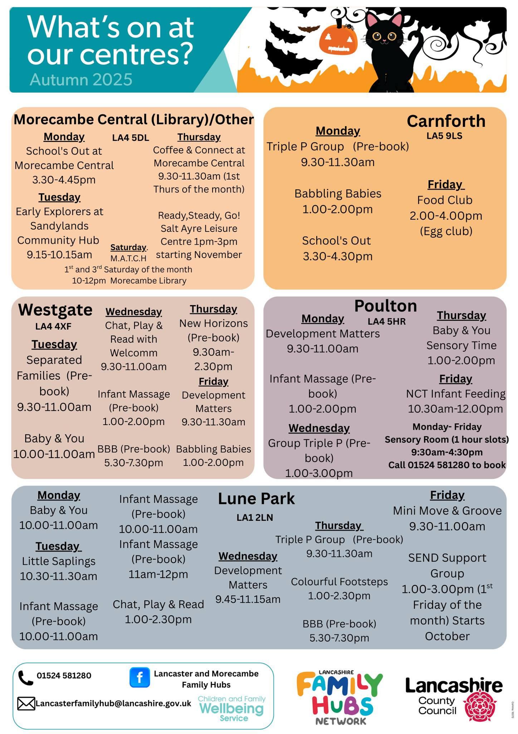


Slide 26
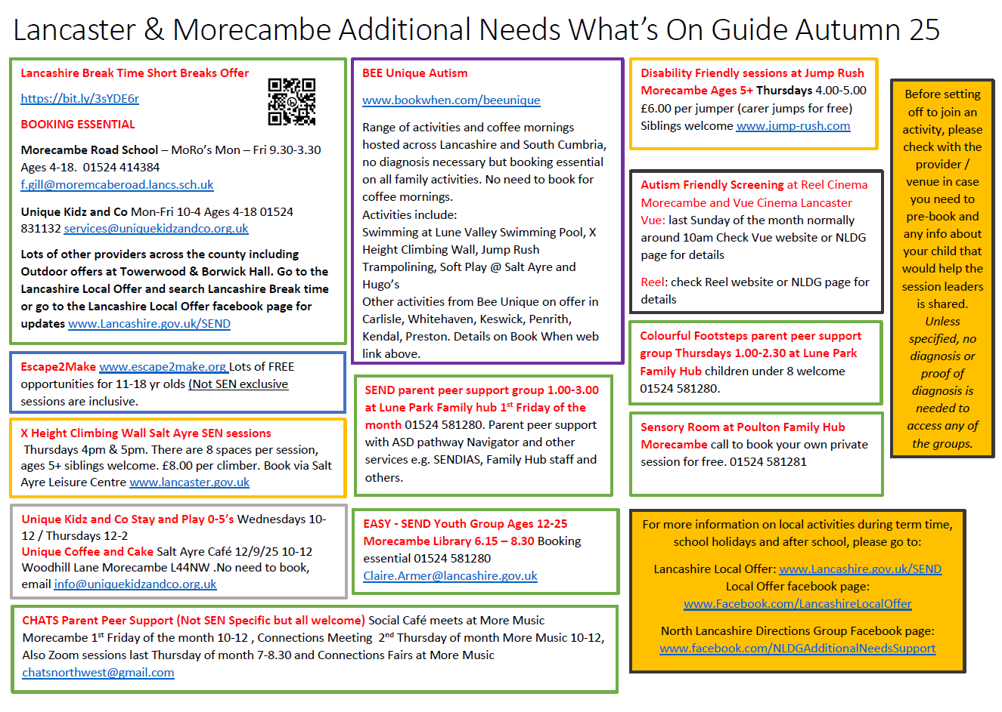
If there are other groups or services you think should be included on this guide please email LMChildAutism@lscft.nhs.uk

Slide 27

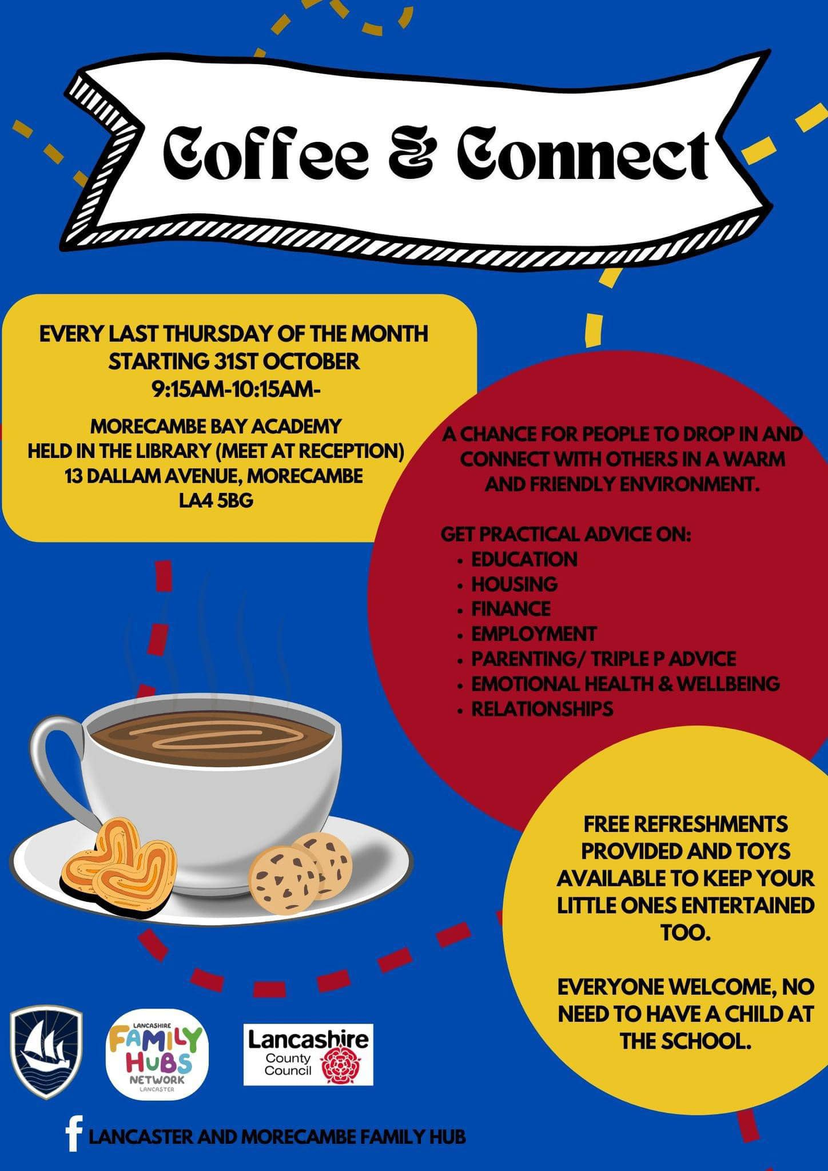

Slide 28

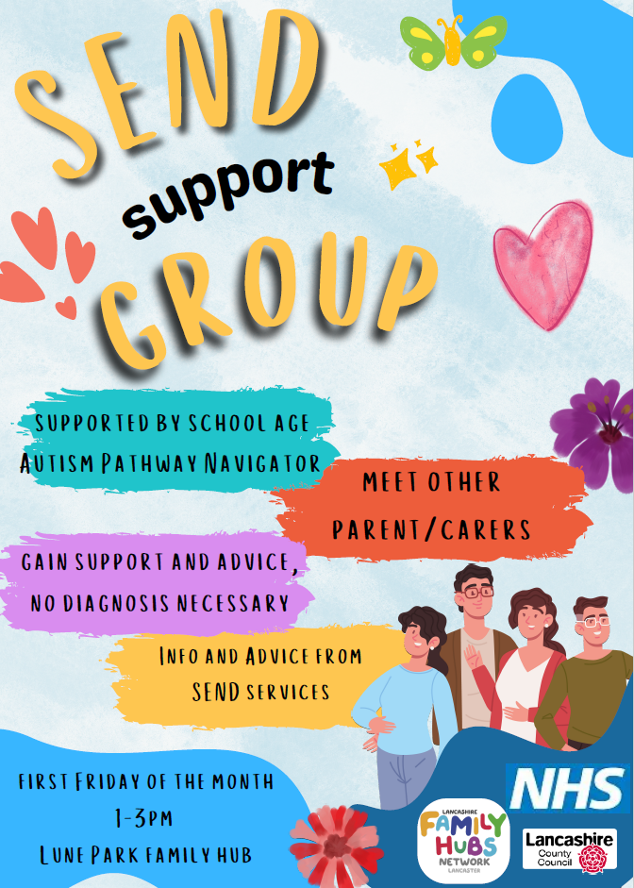

Slide 29
OTHER SUPPORT
SENDIAS Independent Advice and Support Service Lancashire can offer unbiased advice and support when accessing Education, health and social care services. Offer advice and potentially can support in meetings with schools to be your advocate if you need that kind of support. Self refer via form on website. www.lancssendias.org.uk 0300 123 6706 information.lineteam@lancashire.gov.uk
Lancashire Local Offer
Website: https://www.lancashire.gov.uk/children-education-families/special-educational-needs-and-disabilities/ Local Offer Facebook page: https://www.facebook.com/LancashireLocalOffer
Lancashire County Council SEND Newsletters www.lancashire.gov.uk/children-education-families/special-educational-needs-and-disabilities/getting-help/send-newsletter/
Contact Listening Ear Service contact.org.uk/help-for-families/listening-ear/
Listening Ear service offers hour-long 1-1 telephone appointments with a family support adviser.
Where the helpline provides information and advice, Listening Ear is for parent carers looking for emotional support and reassurance – though we can provide practical help too. Bookable slots via website.
Young Minds Parent Helpline supports parents and carers who are concerned about their child or young person's mental health. They can provide detailed information and advice, emotional support and signposting. You can speak to them over the phone or chat online via website link. When closed, you can still leave a message and they’ll get back to you in 3-5 working days.
Opening times: 9.30am-4pm on Mondays, Thursdays and Fridays; 9.30am-6pm on Tuesdays and Wednesdays 0808 802 5544 www.youngminds.org.uk/parent/parents-helpline/

Slide 30
Now your child / young person has a diagnosis, you might want to consider doing the following things:
Completing a hospital passport for them in case they ever need to go into hospital. This will enable any staff supporting you and your child / young person to know about any sensory or physical adjustments that might make the experience more successful.
www.uhmb.nhs.uk/get-involved/patient-experience/care-and-communication-passports
Making an application for DLA Disability Living Allowance if under 16 or PIP Personal Independence Payment for young people over 16. A diagnosis isn’t essential to make an application, but it can help.
More information can be found on this link
https://www.northlancsdirectionsgroup.com/benefits-advice
Other benefits are available after DLA awarded like www.gov.uk/carers-allowance
additional Universal Credits/ Tax Credits.
Grant funding from www.familyfund.org.uk
As a parent / carer of a child / young person with an ASD diagnosis, you should register yourself as a carer with your GP. This should allow you some adjustments when asking for appointments and requesting support. Adjustments vary by practice. You will also be offered Flu and COVID jabs as a carer.

Slide 31


Slide 32
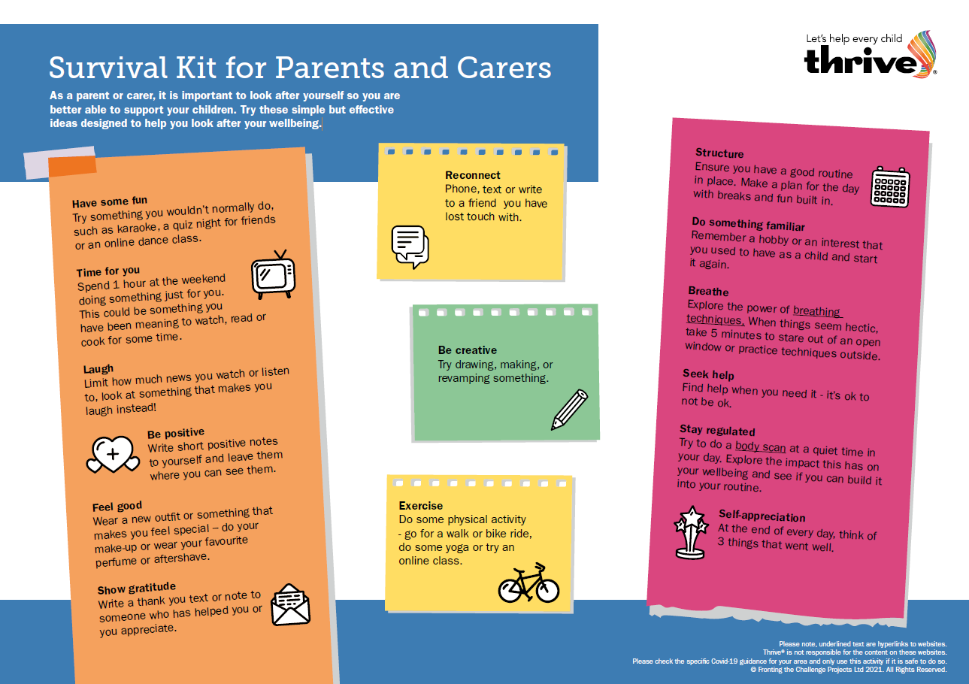

Slide 33
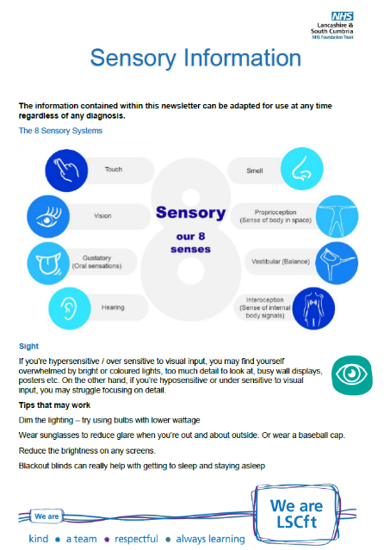
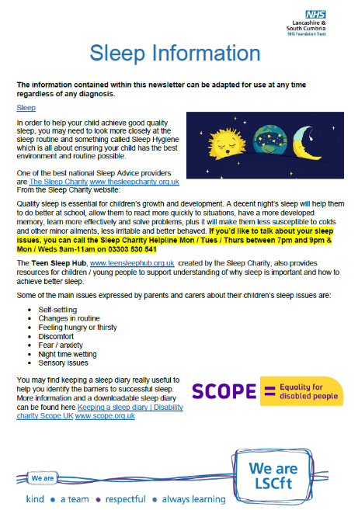
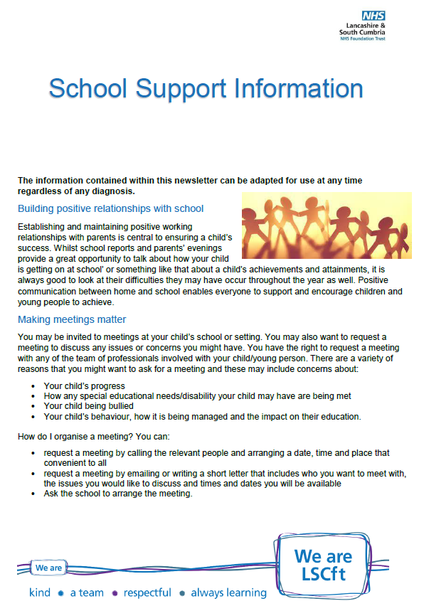
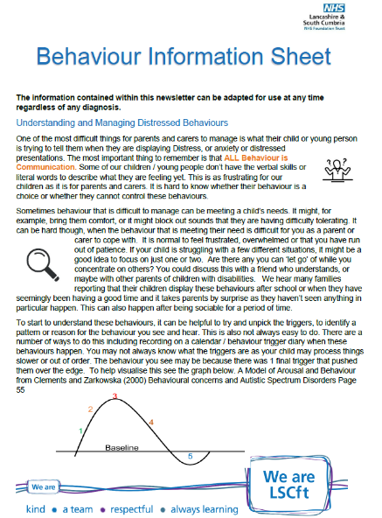
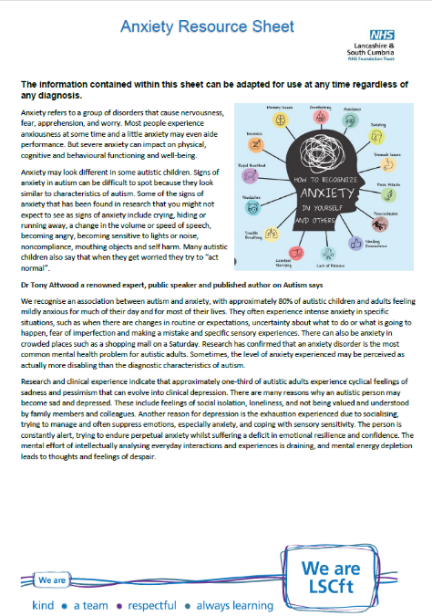
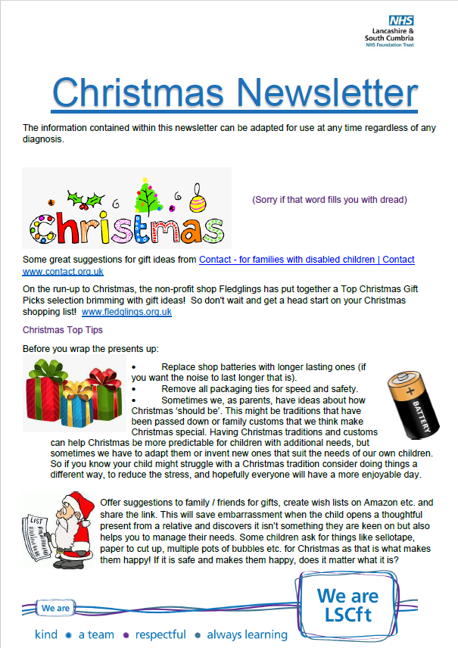
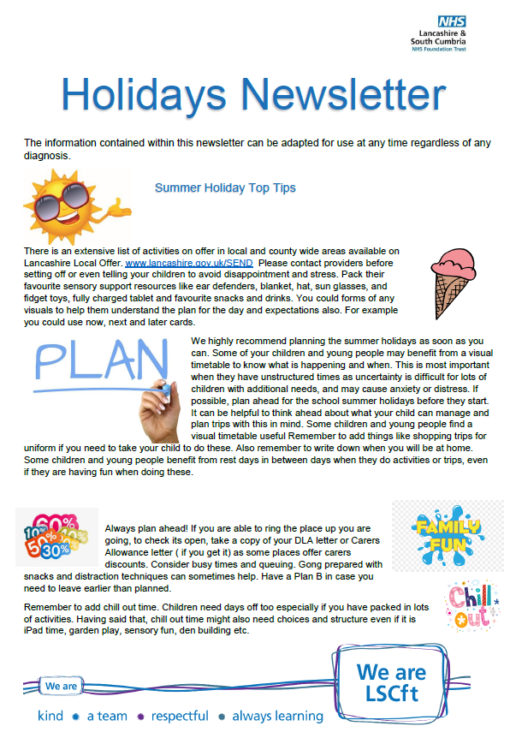
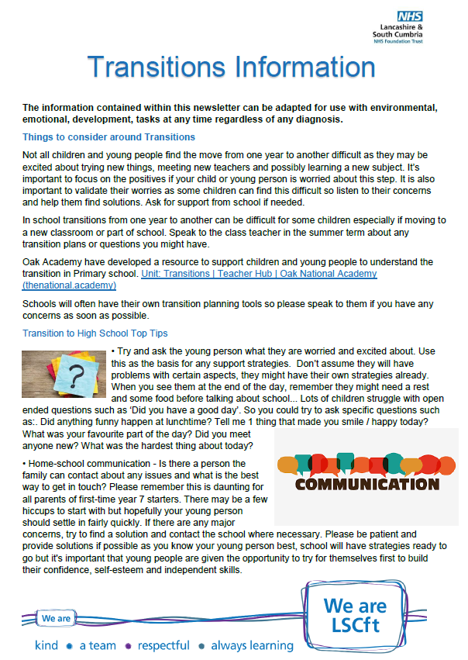
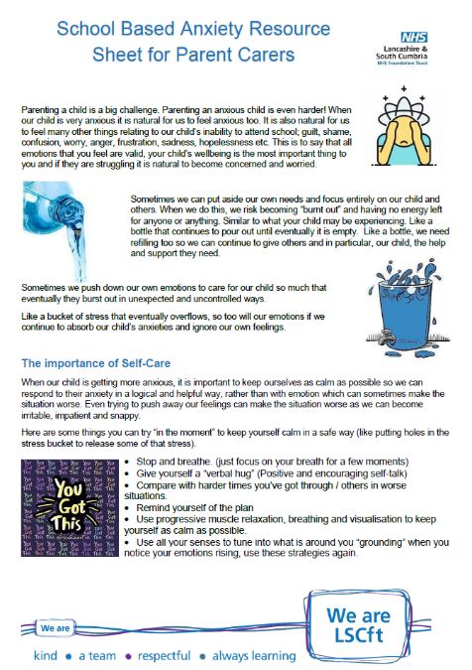

Slide 34

The Sleep Charity advice: https://thesleepcharity.org.uk/information-support/children/common-sleep-problems-in-children/
Available Monday/Tuesday/Thursday evening 7-9pm
Monday/Wednesday morning 9-11am 03303 530 541
Teenagers Sleep Hub: https://teensleephub.org.uk/
Barnardo’s Young Carers Lancashire - https://www.barnardos.org.uk/what-we-do/services/lancashire-young-carers 01772641002 lancashireyoungcarers@barnardos.org.uk We support Young Carers under the age of 18 who provide regular and ongoing care and emotional support to a family member who is physically or mentally ill, disabled or misuses substances and are significantly affected by their caring role. Facebook page with updates: https://www.facebook.com/Barnardos-Lancashire-Young-Carers-340837683505917

Slide 35

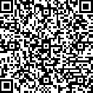
http://ratenhs.uk/zsAYPg
To give feedback on the service you have received from the team please go to the link and select LD Children’s Team – Lancaster and Morecambe
or use the QR code

