Slide 1
Lancaster & Morecambe
CYP Support offers to be used in conjunction with
Mental Health Champions Pathways Document
Version 7 Sept 2025

Slide 2

Mental Health Champions Network
Primary Mental Health Workers PMHW@LancasterandMorecambe@lscft.nhs.uk
01524 550650
Wendy.hart@lscft.nhs.uk 07507845966 Working days Tues, Wed and Thursday Charmaine.rothwell@lscft.nhs.uk Working days Wednesday – Friday
We are here to support you to support the children, young people and families you work with. We offer advice and consultations about young people’s mental health and referrals to CAMHS, Child Psychology, ADHD and other services.
We offer workshops, training, Youth Mental Health First Aid and team learning / reflection sessions. We facilitate the Mental Health Champions Network meetings and Pastoral Partnership meetings. We are here to promote professionals wellbeing and mental health too. We are available via phone or email.
Please contact PMHW to join the network for updates that are sent regularly by email
Network meetings
Join us at our upcoming MHC meetings

Slide 3

Moving Mindsets - Morecambe Bay Mental Health Support Teams
morecambemhst@barnardos.org.uk
www.barnardos.org.uk/get-support/services/moving-mindsets-morecambe-bay-mental-health-support-teams
Referral form on website link above
Service offer:
Low mood, general anxiety, Irritability/Anger, Panic management, Mild obsessive – compulsive difficulties, social anxiety, Emotional regulation, negative thinking, relationships, Mindfulness, group support, individual support ad much more.

Slide 4
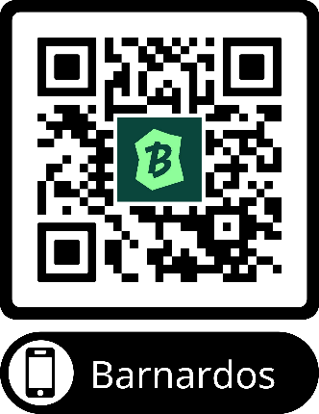
Lancashire and South Cumbria Thrive Service
Mental Health Support Service
01772 505138 thrivelsc@barnardos.org.uk
www.barnardos.org.uk/get-support/services/lancashire-and-south-cumbria-thrive-service
The service offers therapeutic one-to-one, group work and counselling support to children and young people aged 5 to 18 (extending to 25 years based on SEN need) within the whole of the Lancashire & South Cumbria Integrated Care Board (ICB) area.
Please note: The My Time to THRIVE Service is NOT a crisis service. We provide support to children & young people with low – moderate mental health needs. Services supporting children and young people's emotional health and wellbeing. We have centres where children and young people can visit and have a trained worker they can trust and talk to. We help them build their confidence and get to the root of their difficulties.
If you need urgent support, please contact your GP, the local CAMHS Crisis Team (via 0800 953 0110) or in an emergency situation, you should consider contacting Emergency Services or visit your local A&E department or Urgent Care facility.
Here are some other services and organisations, that may also be useful to you:
www.kooth.com
www.youngminds.org.uk
www.every-life-matters.org.uk

Slide 5

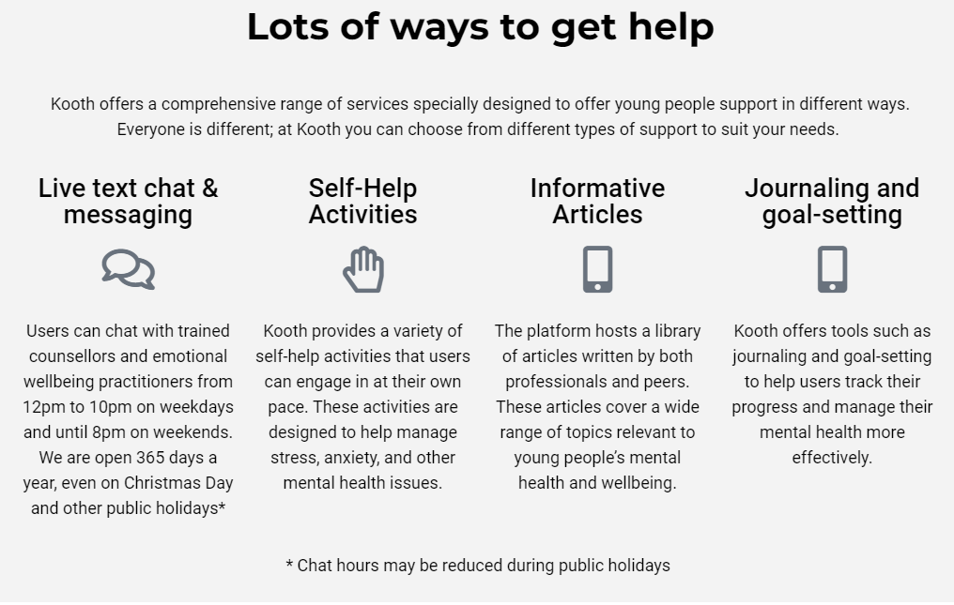
Kooth
Mental Health Support
www.Kooth.com

Slide 6
Information for practitioners
Kooth information sessions for professionals who work with young people and families, To access the teams meeting, please email the date of your choice to hhook@kooth.com
18th of November 3:30 - 4:00 20th November 3:30 - 4:00 25th November 3:30 - 4:00 4th December 3:30 - 4:00
If you would prefer a staff training session just for your team, please let me know. This could be as part of a teams meeting or as a stand alone session. Please note that I currently don't have availability for any separate meetings until the new year.
Kooth: Digital mental health service does not make more work for staff, as there is no referral process to follow and no paperwork.
We can help to de-escalate risk out of hours as practitioner's are online until 10pm each night, as well as alleviates pressures on other service and waiting lists by being another layer of support, available 24/7, 365 days a year.
You may have heard of Kooth, but are unclear on our safeguarding or moderation processes. The brief Kooth webinars will provide clarity around this.
There is not a single word published on the platform without it first being checked by our moderation team. Our safety processes are stringent and inline with existing standards. Young people are unable to interact with each other and are anonymous to each other. All content created for the site is age-gated to ensure content is age appropriate.

Slide 7

Lancashire Mind Peer Support Programme
www.lancashiremind.org.uk/project/childrens-peer-support/
North Lancashire Contact charlottesutton@lancashiremind.org.uk
Through innovative, peer-led support systems, this programme aims to enhance the mental health and wellbeing of young people aged 10 to 19 (up to 25 with SEND) across Lancashire. With children facing an alarming increase in mental health challenges, we can help support them to find coping strategies and build resilience.
Our Peer Support Programme is run across Lancashire. The project offers multiple routes for young people to access the support they need, tailored to their individual wellbeing needs. The key elements of the programme include wellbeing assessments, diverse support routes, and the training of community peer support mentors.
Support Available
The initiative addresses the growing prevalence of mental health issues among young people. We deliver a range of wellbeing provisions within the programme, including:
1:1 Peer Support Wellbeing Coaching (virtual sessions)
Support to access existing community groups
Signposting to specialist support
Peer support training
Establishing new groups for young people

Slide 8
Support Routes:
Route A – Social Prescribing:
A social prescribing approach is used to signpost the young person into existing services.
Support is provided as needed over a 2-month period.
Route B – Targeted Peer Support Groups
Attendance at or creation of a specifically targeted peer support group.
Groups may focus on LGBTQIA+, looked-after children, racialised communities, neurodiverse-specific needs, young carers, etc.
Route C: Wellbeing Coaching
For young people not ready to attend a group setting.
Wellbeing coaching involves a 6-week, 1-to-1 coaching intervention through Lancashire Mind.
Route D: Specialist Support Services
Our support coordinator refers the young person into other specialist support services, such as ADHD support, addiction support, debt management, etc.

Slide 9
Free Lancashire Mind course on Mental Health and neurodiversity called Supporting Your Child
Training for Parents
Supporting Your Child with emotional wellbeing and/or neurodiversity. A course for parents looking for tools and strategies to support the emotional health and wellbeing of their child.
www.trainingondemand.lancashiremind.org.uk
More information/video intro: https://www.youtube.com/watch?v=CXM2fnTiWhI
It is offered at no cost. It is for anyone interested in supporting mental wellbeing in their children but includes information specifically about mental wellbeing and neurodiversity (ADHD, autism, dyslexia and related mental differences). It has been created based on feedback from professionals, parents and those who are neurodivergent and/or who have had difficulties with their mental wellbeing.
There is a downloadable support kit at the end of the training full of practical ideas to support you and your child.
You can register and enrol here: https://trainingondemand.lancashiremind.org.uk/
Learning Objectives
Improve basic knowledge around neurodiversity
Understand the importance of mental health
Learn tools and techniques to support emotional wellbeing and self esteem
Recognition of the importance of communication and family cohesion
Disclaimer: This is not a specific mental health or neurodiverse diagnoses course. This is not a course for parents whose children or parents/carers who are in crisis. Both mental health and neurodiversity are broad spectrums of experience. This course is intended to provide parents and carers with tools and techniques to maintain communication and family cohesion, whilst navigating the challenges of parenting and the journey of seeking support. Difficult thoughts and feelings have intentionally been omitted to ensure that all our learners feel safe and supported throughout the session. For more information on our 'live' parenting workshops supported by trained facilitators, which do tackle more challenging topics, please contact training@lancashiremind.org.uk.
If your child is in crisis, please reach out to local NHS support by calling 999 for urgent support or contacting 111 (select 2) for non urgent support or speak to your GP.

Slide 10

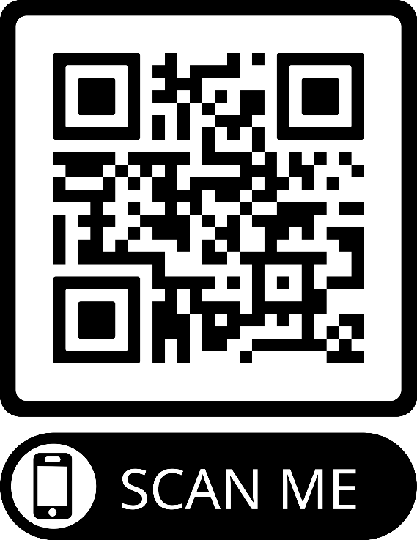




www.autism.org.uk/advice-and-guidance/topics/resources-for-autistic-teenagers

Slide 11

www.pandasonline.org (As recommended by Anna Freud Organisation)
NeuroBears is a course all about the autistic experience.
NeuroBears is for autistic young people, they can share it with their safe adults and family.
NeuroBears has been created by autistic adults in collaboration with autistic young people.
Neurobears 2.0 has approximately 90 minutes of videos, broken down into 12 video sessions. The course is accompanied by young person and adult workbooks. The topics covered are:
A brief history of autism
A positive strengths-based diagnosis model
Autism Myths
Neurodivergence - Autism + environment = outcome
What autism isn’t – co-occurring conditions
Autism and sensory experience
Autistic overwhelm, meltdowns, and shutdowns.
Autistic communication
Autistic Masking
Spoon Theory and Autistic burnout
Autistic identity
Examples and personal experiences
NeuroBears Cubs
License for Home Use £45
Lifetime Access
Educational Video Session
Accompanying Workbook
Developed by Neurodivergent Trainers
Engaging and Fun
NeuroBears 2.0
License for Home Use £75
Lifetime Access
12 Video Sessions
Accompanying Workbooks & Materials
Developed by Neurodivergent Trainers
Engaging and Fun

Slide 12

www.lmc.ac.uk/courses/a-z-courses/understanding-autism-level-2
Understanding Autism - Level 2
Over the 8 - 12 weeks you will be required to complete a series of mandatory units.
Unit 1: Common traits and diagnosis of Autism Spectrum Disorder
This unit will provide you with an understanding of autistic spectrum conditions, the dyad of impairments and the importance of professional diagnosis of autism spectrum conditions. (Please note: This unit discusses Autism diagnosis using levels which is not something the NHS use in this area for diagnostic purposes)
Unit 2: Sources of information, support, legislation, and guidance relevant to Autism Spectrum Conditions
This unit covers the legislation and guidance relevant to autism spectrum conditions and helps you to understand ways to support individuals on the autism spectrum. This unit will also help you to understand the help and support available for individuals with autism spectrum disorder.
Unit 3: Living with Autism Spectrum Conditions
This unit covers the effect autism spectrum conditions have on an individual’s sensory experiences, the impact those conditions have on the family of an individual on the autism spectrum and the societal impact on individuals on the autism spectrum. This unit will also help you to understand the impact of the physical environment upon individuals on the autism spectrum.
Unit 4: Best practice relating to Autism Spectrum Conditions
This unit covers the experience of living with autism, how to support individuals to maintain their personal safety and the purpose of positive risk-taking. This unit will also help you to know how to support individuals with transitions, life events, accessing services and facilities and how to support individuals with employment.
On completion of this course you will receive a Level 2 Certificate in Understanding Autism, from TQUK.

Slide 13
www.lmc.ac.uk/courses/a-z-courses/special-educational-needs-and-disability-rqf-tquk-level-2
Special Educational Needs and Disability (RQF) TQUK Level 2
You will study the following 5 mandatory units:
Unit 1: Introduction to Special Educational Needs and Disability (SEND)In this unit, learners will explore a range of SEND conditions and the causes of these, as well as the social and medical models of disability. They will also learn about barriers that individuals with SEND might face and positive changes that have occurred over time in relation to SEND.
Unit 2: Understand equality and diversity in the context of SEND Learners will look at equality, diversity and inclusion within the workplace, community and wider society, as well
Unit 3: Principles of promoting person centred approach for individuals with SEND Learners will learn about the person-centred approach in relation to send, and the importance of active participation for individuals. They will also look at well-being and how this can be promoted.
Unit 4: Understanding SEND and learning Learners will explore different learning styles and support programmes used in educational settings. They will also learn about reasonable adjustments and how Education, Health and Care (EHC) plans work.
Unit 5: Living with Special Educational Needs and Disabilities (SEND)Learners will learn about neurodiversity and self-identity, as well as how societal and cultural influences can impact on individuals with SEND. They will also look at the support available for individuals with SEND and their families, as well as the effects of stigma.

Slide 14

Bay Medical Group Young People’s Social Prescribers
www.baymedicalgroup.co.uk/bay-icc-enquires
www.baymedicalgroup.co.uk/young-persons-social-prescribers
Our Young Person’s Social Prescribing Service is delivered in partnership with Stanley’s Community Centre and More Music. The Young Persons Social Prescribers can accept referrals for people from age 11 and up to and including people aged 19 who are registered with Bay Medical Group.
Social prescribing can help support people to: make lifestyle changes, connect with groups and activities in the community and includes supportive personalised conversations to help improve health and wellbeing.
Our Young Persons Social Prescribers will make contact with the young people and arrange to meet at an agreed community venue or provide telephone support. We aim to work with young people to understand what matters to them and provide support to empower young people to reach their goals and potential.

Slide 15
BAY ICC MDT Meetings for case discussions. Weekly on Thursdays 2pm via Teams
Bay Integrated care community (ICC) and primary care network facilitate a weekly multidisciplinary team meeting (MDT) for children and young people. The MDT occurs every Thursday from 2-3pm and is held online. The MDT is chaired by Dr Gemma Barrow (GP at Bay Medical group and ICC clinical lead). Regular core members include; Child and Adolescent Mental Health services, Children and Families Wellbeing service, Community children's specialist nurses, social prescriber for young people, Autism pathways navigator and paediatricians as appropriate. Other services specific to cases being discussed will be invited to attend e.g. Police, Children's Social care etc.
The MDT provides an excellent opportunity to have access to a range of services, specialists, knowledge and support for people working with young people who are registered with Bay Medical group. As an MDT group we are keen to ensure that our colleagues in education are aware of this support available and how to access if appropriate. Cases to be discussed must have tried all other avenues for support first to ensure staff time for discussion is used appropriately.
To make a referral for discussion at the MDT please seek consent from the family first then email anji.stokes@mbht.nhs.uk and in the first instance she will liaise with you to answer any questions that you may have about the process.

Slide 16

Carnforth ICC MDT Meetings for case discussions.
Bi-Monthly 3rd Thurs of month 12.30-3.00 via Teams
Carnforth.ICC@mbht.nhs.uk
Carnforth Integrated care community (ICC) and primary care network facilitate a bi-monthly multidisciplinary team meeting (MDT) for children and young people. The MDT is chaired by Consultant Paediatrician Clare Peckham supported by Dr Deboo (Carnforth ICC clinical lead). Regular core members include; Ash Trees Surgery, Child and Adolescent Mental Health services, Children and Families Wellbeing service, Community children's specialist nurses, social prescriber for young people, Autism pathways navigator and paediatricians as appropriate. Other services specific to cases being discussed will be invited to attend e.g. Police, Children's Social care etc.
The MDT provides an excellent opportunity to have access to a range of services, specialists, knowledge and support for people working with young people who are registered with Carnforth Ash Trees Surgery. As an MDT group we are keen to ensure that our colleagues in education are aware of this support available and how to access if appropriate. Cases to be discussed must have tried all other avenues for support first to ensure staff time for discussion is used appropriately.
To make a referral for discussion at the MDT please seek consent from family then email
Carnforth.ICC@mbht.nhs.uk

Slide 17

Lancaster Paediatric ICC MDT Meetings for case discussions. Monthly Thursdays 3.00pm via Teams
Lancaster Integrated care community (ICC) and primary care network facilitate a monthly multidisciplinary team meeting (MDT) for children and young people. The MDT occurs monthly on a Thursday from 2.30pm and is held online. The MDT is chaired by Ceri Hurst Clinical Leader, Community Children's nursing team
Input from a GP at Lancaster Medical Practice. Regular core members include; Child and Adolescent Mental Health services, Children and Families Wellbeing service, Community children's specialist nurses, Autism pathways navigator and paediatricians as appropriate.
Cases to be discussed must have tried all other avenues for support first to ensure staff time for discussion is used appropriately.
To make a referral for discussion at the MDT please gain consent from the family first then email Ceri.Hurst@mbht.nhs.uk

Slide 18

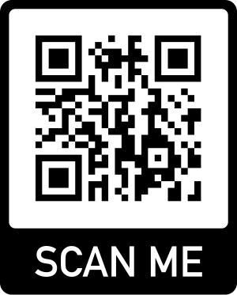
Lancashire SENDIAS
www.lancssendias.org.uk
0300 123 6706 (Mon-Fri 9am-5pm)
Information.lineteam@lancashire.gov.uk
Provide a service for children and young people with special educational needs and disabilities, aged up to 25, and their parents or carers. We give support around SEND issues at every stage of a child’s education, including into further education and adulthood. The service offers: signposting, printed and online information, email / phone information and advice, face to face support
We will:
aim to respond to your enquiry within two working days (depending on capacity)
help you to express your views and resolve issues
assist with paperwork relating to EHCP’s where needed
maintain information provided on a secure and confidential database
provide telephone advice and information
meet with you, if required
attend meetings with you, if needed
maintain confidentiality, in accordance with local safeguarding procedures
We will not:
contact other people on your behalf without your prior consent
pass your information on to other organisations without your agreement
make decisions on your behalf
attend meetings or provide reports in your absence
provide transport to/from meetings (except in exceptional circumstances)

Slide 19

Lancaster District Directory
digitaldirectory@lancastercvs.org.uk
01524 555900
https://directory.lancastercvs.org.uk
This site is your opportunity to find out about services and activities delivered by community-based groups and the public sector across the Lancaster District.
The Directory helps you to get in touch with services that provide support, no matter what your stage in life or needs might be. We feature groups and organisations working with:
Families, children and young people
Older people
People with specific physical and mental health needs
People who need advice on money, debt and housing
Households who require help with food and nutrition
Those who need social care and support
People interested in finding social events and hobbies
Try browsing the Directory by category, type of activity, or find out what's available close to home by using the postcode search and interactive map. You'll find full descriptions of services and activities alongside contact details and links to help you access what you need. Some providers also allow you to refer yourself to their services, or make bookings directly into workshops, courses and advice sessions, alongside tools that help you to measure the impact they have on your wellbeing.

Slide 20

Find local services
https://events.apps.lancashire.gov.uk/w/webpage/all-events?service=ALL
Lune Park Family Hub
Ryelands Park, Owen Road,
Lancaster,LA1 2LN
Email: lancasterfamilyhub@lancashire.gov.uk
Telephone: 01524 581280
The Children and Family Wellbeing Service (CFW) offers a wide range of support across the 0-19yrs+ age range (25 years for SEND) with a 'whole family' approach.
The service identifies as early as possible when a child, young person or family needs support, helping them to access services to meet their needs, working with them to ensure the support offered is right for them, is offered in the right place, and at the right time.
The main focus of the service is to provide an enhanced level of support to individual children, young people or families with higher levels of need. Service resources are prioritised towards identified priority target groups or individuals at risk who are assessed using Lancashire's www.lancashire.gov.uk/practitioners/supporting-children-and-families/early-help-assessment/ as having more complex or intensive needs.
Coffee and Connect at Morecambe Library for families to seek advice from a range of services.
1st Thursday of the month 9.30-11.30 pre school children welcome.
Coffee and Connect at Carnforth Family Hub Sept 13th, 20th, 27th (Oct dates TBC) 1.30-3.30

Slide 21

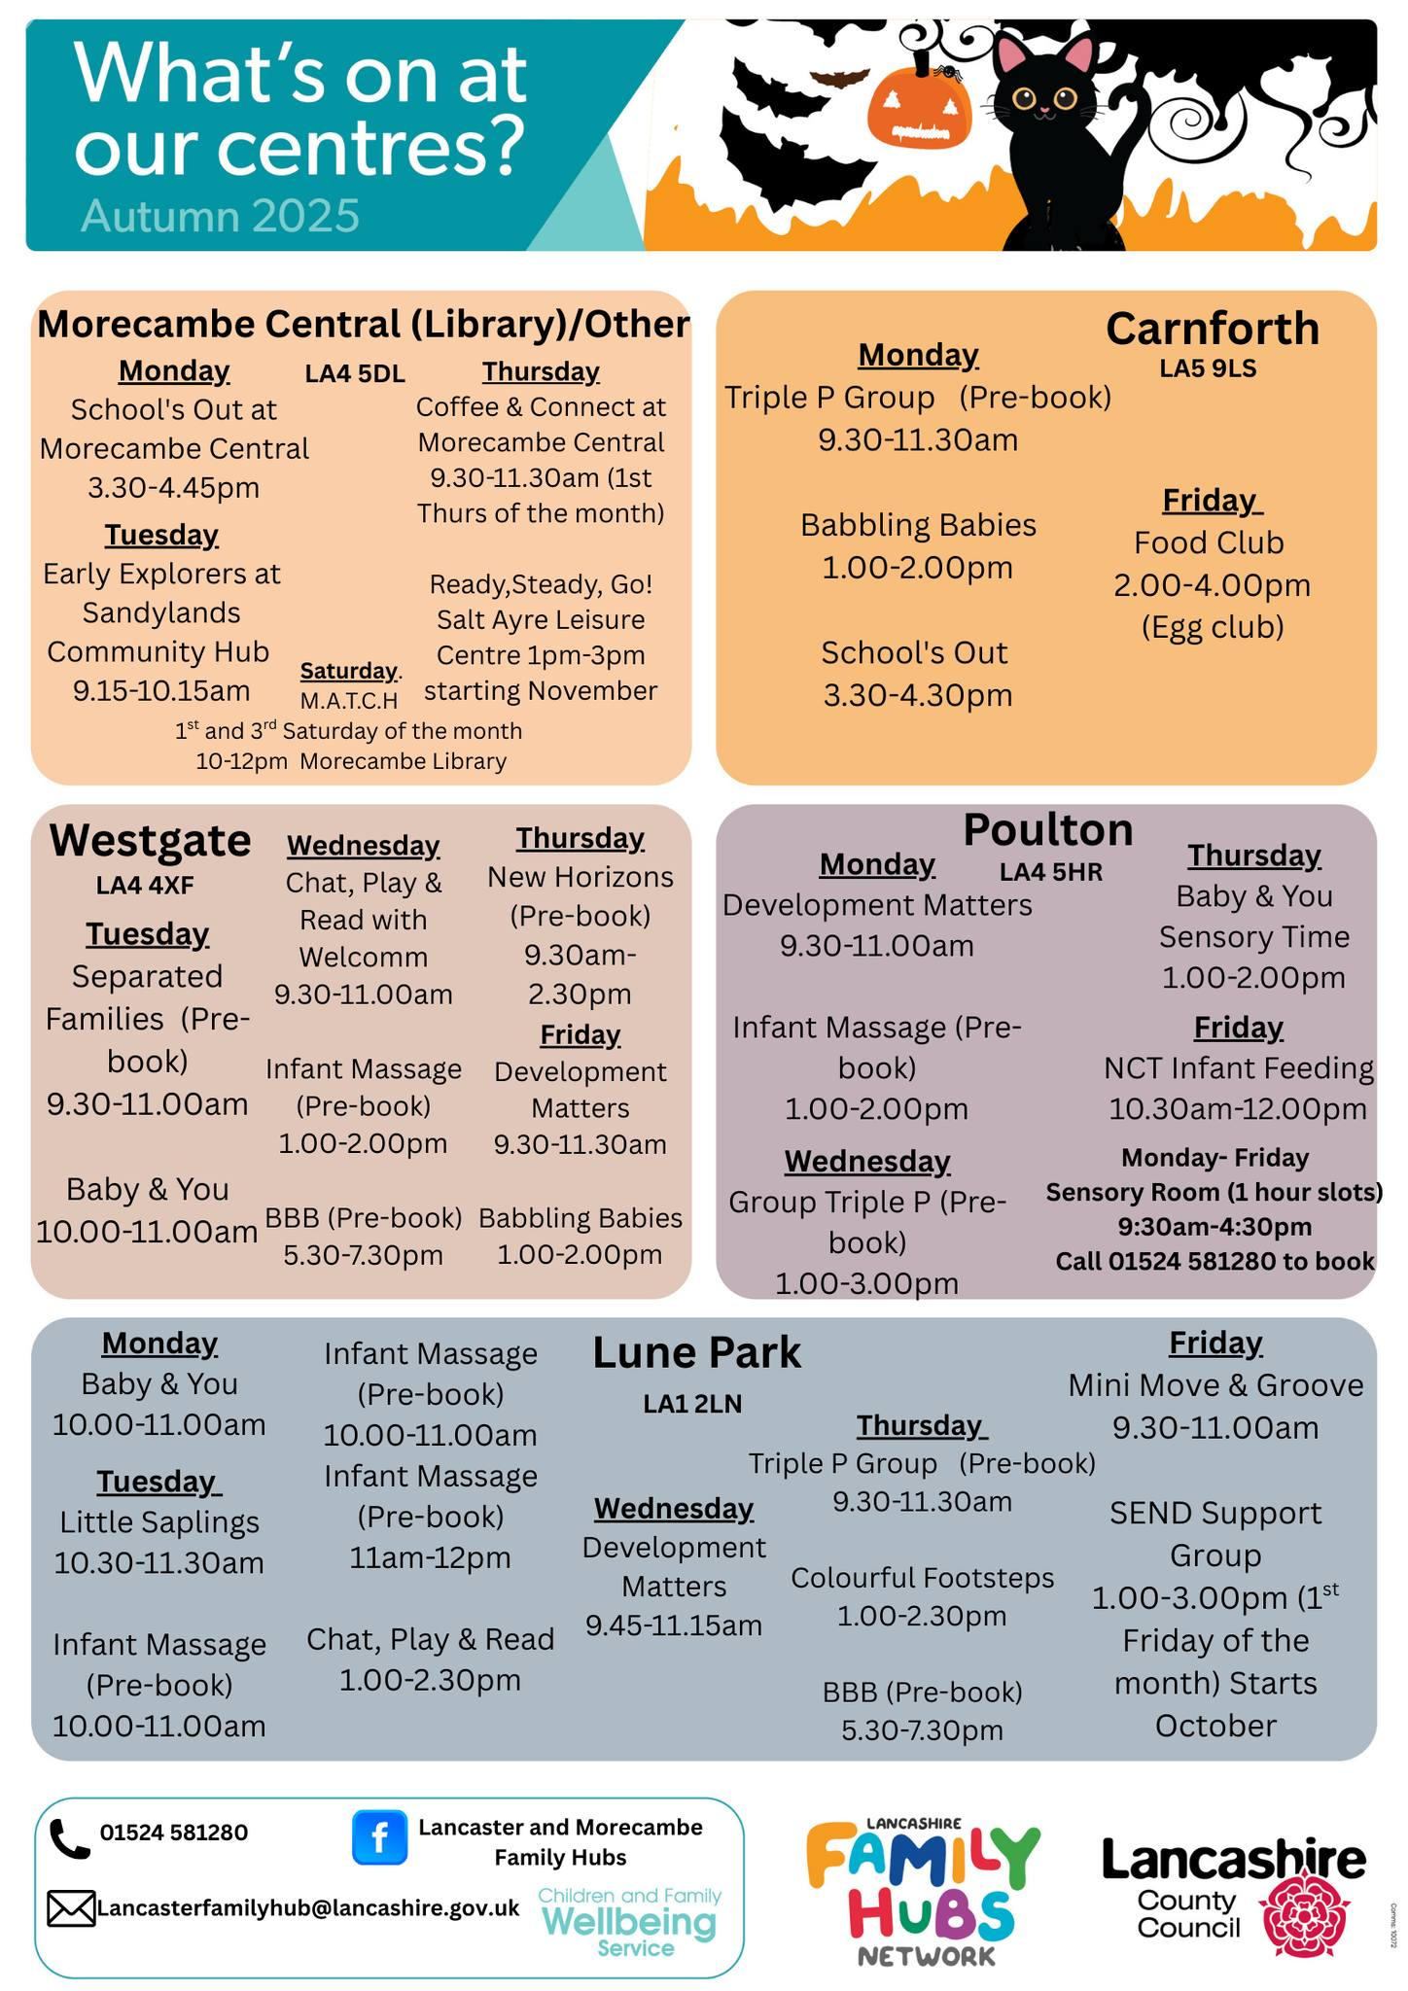


Slide 22



Slide 23



Slide 24
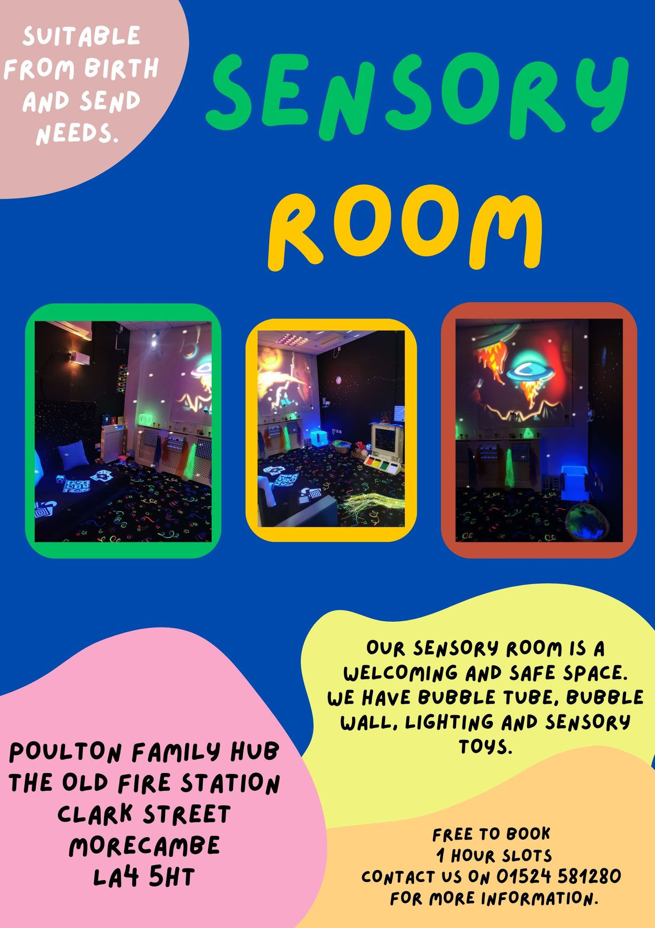
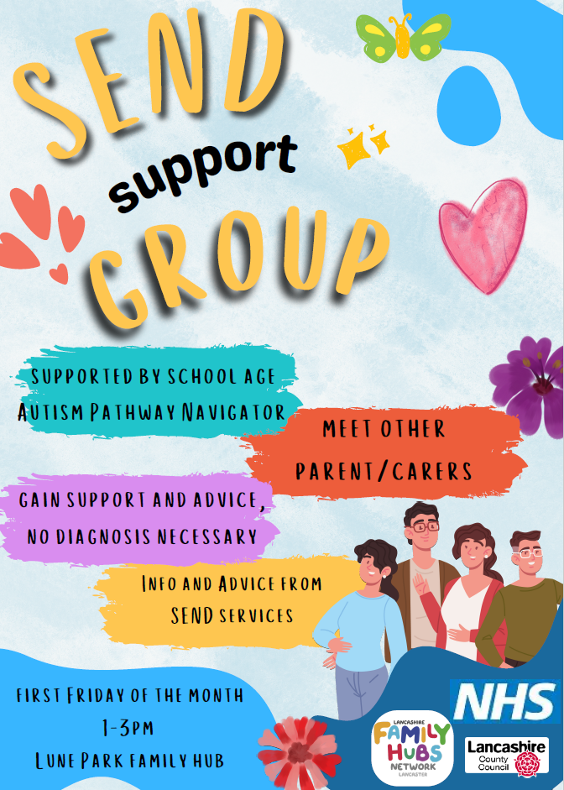

Slide 25


Referral Criteria:
Parent/carers of Children and young people aged 0-16
Referral by professional working with the family or parent/carer self referral.
Support Offer:
Group delivery in person over 15 weeks term time only
Group Triple P (8 Weeks) consists of:
5 group sessions (2 hours each)
3 individual phone conversations (20-30 mins)
Group Triple P is suitable for parents with concerns about their child’s behaviour or who wish to learn a variety of parenting skills that will promote their child’s development and potential.
Stepping Stones Group (9 Weeks) consists of:
6 group sessions (2.5 hours each)
3 individual phone conversations (20-30 mins)
Group Stepping Stones is suitable for parents/caregivers of children with a range of additional needs (e.g. intellectual disability, autism spectrum disorders, cerebral palsy, waiting on assessment) who wish to learn a variety of parenting skills that will promote their child’s development and potential.

Slide 26

Community Paediatrics
Longlands Child Development Centre Lancaster
01524 519710
Commpaeds.lancaster@mbht.nhs.uk
Referral criteria
Aged 0-19 and registered at a North Lancashire GP
Referrals can be made from health professionals including GPs, Health Visitors, School Nurses, Psychologists, Hospital Doctors, Community Nurses, Therapists, educational psychology, children`s social care & specialist teachers. This service does not accept self-referrals.
We do not accept referral where behaviour is the main presenting feature unless a paediatric developmental assessment is required as other services are more appropriate to advise these families on behaviour management.
Service offer
Children where there are concerns about delayed or atypical development including neurological conditions, cerebral palsy, complex Neurodisability and genetic conditions associated with delayed development or learning difficulties
Preschool children with social communication difficulties including Autism assessment
Medical assessment and advice for Education Health and Care plans (EHCP) for children known to our service with identified special educational needs
Medical assessment and advice for Children in Care or those undergoing adoption
Children attending special educational needs schools (Morecambe Road, Loyne and Bleasdale) when required.

Slide 27
Early Years Social Communication pathway
01524 519710
Commpaeds.lancaster@mbht.nhs.uk
Referral Criteria:
A referral to Longland’s CDC (Child Development Centre) social communication pathway can be made for a child from 18 months until March 31st in the year that they start school. Referrals can only be made by health professionals.
Be registered at a GP practice in the Morecambe Bay area
No separate referral is needed for speech concerns if a child has been triaged on this pathway. ​
On acceptance of referral , parents will be sent a questionnaire to complete, along with a (TOP) Teacher Observation Profile if in attendance at nursery/childminder.​
Assessment made through clinic appointment with consultant and home & nursery visit by Speech and Language therapist.​
Declined referrals will be sent back to the referrer.​
Support Offer:
This service is to support families of children who are referred to Longlands CDC with a social communication difficulty including Autism. The team includes ; early years nurses, a child development practitioner, speech therapists and a pathway navigator. The nursing team will complete development checks, offer home visits to carry out episodes of care including support, sleep , toileting and behaviour for children with additional needs.​

Slide 28
Early Years Social Communication Pathway
Assessment Process:
Stage 1 - Identification at triage
Accept/Decline
Stage 2 - Information gathered via questionnaires, via Speech Therapists and Consultants.
Introduction call from Pathway Navigator.
Stage 3 - Discussion with Professionals and Feedback appointment offered to families.
Stage 4 - Follow up call after feedback to offer further support .

Slide 29
Speech and Language Therapy Service
Advice line Tuesdays 9am-11am - 07816 194918 or 01524 591671
email sltadvice@mbht.nhs.uk
www.uhmb.nhs.uk/our-services/services/paediatric-hospital-and-community-services/integrated-childrens-nursing-and-therapy-team/childrens-speech-and-language-therapy
Referral Criteria: The Children’s Speech and Language Therapy service is for children aged 0-16 with speech, language, communication and/or eating and drinking difficulties.
This might include:
Children who are taking longer than expected to learn to talk
Children with limited vocabulary, who struggle to form sentences, or who get their words and sentences muddled up.
Children who find it difficult to understand what others are saying.
Children who struggle to communicate socially with others.
Children who struggle to say certain sounds or make themselves understood.
Children who stammer.
Children who have problems with their voice.
See webpage for further details on what the service does not cover.
Referrals accepted from a variety of different professionals including Health Visitors, GPs, Medical Consultants, teachers. Referrals from parents are not accepted. Please provide clear information about the specific difficulties. For example if it is a speech sound issue then to write down how some words are said, or if it is language then to write down the sort of sentences that are used.

Slide 30
Children’s Bladder and Bowel Team
Integrated Children's Nursing and Therapy Team
01524 518966
The service is open Monday - Wednesday, 9am - 4.30pm.
Advice and guidance hotline every Wednesday between 2pm - 4pm.
Service offer: ​
constipation from 0-18 years​
day time wetting from 3.5 years if toilet training has been achieved​
nocturnal enuresis aged 5 years
children with neuropathic bladder and/or bowel from birth
core training packages for schools of up to 4 Teaching Assistants as required for procedures such as Intermittent Self Catheterisation.
Referral forms on website to be sent to ​ icntteamreferrals@mbht.nhs.uk

Slide 31
School Aged Autism Assessment Team
01524 550331
LMChildAutism@lscft.nhs.uk
Referral by form to Referral hub LDReferralHub@lscft.nhs.uk
Referral Criteria: (refer to Top Tips Guide)
Children in Reception year at Primary School until 16th birthday
Be registered at a GP practice in the Morecambe Bay area – check with team if unsure.
Referral by professional who knows the child/young person the best on Part A of the referral form. Part B from parent /carer is optional but helpful to aid discussion.
Assessment Process:
Referral sent to the hub by email then sent to local team for processing.
Triaged within a week – checked for content to warrant further assessment, age, GP and consent must be marked on the form.
Family, referrer and GP notified if accepted / rejected by letter.
If accepted, family to contact the team to receive questionnaires within 3 weeks or discharged.
Questionnaires sent to home and school by email with online links. 3 week deadline for returns or discharged if not returned.
Initial Assessment completed using questionnaires, referral info and any other documents sent.
Decision made to progress for full assessment / further info gathering via observation or discharged after observation if further assessment not indicated. Conversation with family if discharged, letter sent with next steps guide if referral kept for full face to face assessment.
Face to face assessment including ADOS in clinic and ADI with parent. (3 year wait from initial assessment to this point currently).

Slide 32
School Aged Autism Assessment Team consists of
Learning Disability Nurses, Speech and Language Therapists, Consultant Paediatricians, Clinical Psychologists, Pathway Navigator.
Support whilst waiting for assessment:
Telephone / email support at any time until they have been discharged
One off 2 hour workshops online on Behaviour, sleep and sensory
Access to Pathway Navigator with lived experience by phone, email, Teams call, monthly drop in at Family Hub to talk through concerns, support with questionnaires and signposting to other services and support.
Access to resources on a range of topics to support understanding of presenting issues.
Support following assessment:
If assessment concludes not Autistic, signposting given in information pack during discussion with team and detailed report provided then discharged.
If threshold for Autism diagnosis reached, information pack given during discussion with team and detailed report provided.
Family Connect Post Diagnosis information session for parents delivered online with 2 members of the team.
This Is Me programme for young people aged 11-14 – opt in service at anytime until 14th birthday. Builds self esteem, connection with others and helps them understand their diagnosis.

Slide 33
Children’s Community Learning Disability Team
01524 550331
LDChild.Bay@lscft.nhs.uk
Referral by form to Referral hub by professional or parent/carer LDReferralHub@lscft.nhs.uk
Referral Criteria:
Children and young people aged 0-18
Be registered at a GP practice in the Morecambe Bay area
Referral by professional working with the family or parent/carer self referral.
Service works in episodes of care, therefore should your child or young person have been known to us in the past parents/carers are able to self refer.
Evidence of Moderate or Severe Learning Disability
Need support for Behaviours that challenge, emotional literacy, Anger management, anxiety, sensory awareness, sleep, toilet training if there is a behavioural element, puberty, personal relationships and sexual health, keeping safe, family sessions.
Support Offer:
Groups on a range of topics including Behaviour, Sensory and Sleep
1-1 nursing if needs warrant this level of intervention
Learning Disability Team consists of Registered Learning Disability Nurses, Clinical Psychologists, & Occupational Therapist
Support is offered as episodes of care so family wont remain open to the team unless an area of specific need for support is identified.

Slide 34
CAMHS/CPS (Child Psychology Service)& ADHD Team
Harvey House Lancaster
01524 550650
Request for Involvement (RFI) - Complete all sections of the LSCFT referral and Appointment Centre-RFI form
(same RFI form for CAMHS/ CPS / ADHD— indicate which service you are requesting)
Return forms to C&F.ReferralCentre@lancashircare.nhs.uk or lcn-tr.cfreferralcetre@nhs.net
Advice and guidance
Refer to Mental Health Champions Toolkit
Contact the Primary Mental Health Workers based at CAMHS email PMHWLancasterandMorecambe@lscft.nhs.uk
ADHD Referral Criteria: (refer to Top Tips Guide) – referral is for assessment and diagnosis then medication if warranted.
Children aged 6 +. Be registered at a GP practice in the Morecambe Bay area
Referral by professional who knows the child/young person the best. The team need details of intention, hyperactivity, impulsivity - specific examples of each of these areas of difficulty is helpful for the team
Details of emotional dysregulation is important too — behavioural and/or attention problems suggestive of ADHD, severity of the problems, how this affects the child or young person and the parents/carers, the extent to which they impact different parts of their day to day life.
A period of watchful waiting has identified issues in the young person’s day to day functioning which indicates a need for further assessment—the referral should state the issues and what has been identified

Slide 35

CHATS Team
Email: chatsnorthwest@gmail.com
Facebook Page: Facebook.com/morecambechats
Facebook Group: Facebook.com/groups/598047137613422
CHATS (Carers. Help. Advisory. Training. Support) is a support group for parents / carers who have children or young people experiencing emotional or mental health difficulties.
We run a local group on the second Thursday of the month 10am, at 13-17 Devonshire Road, Morecambe, LA3 1QT. We also run online support groups, please keep and eye on the events section of the Facebook group. The group was set up by parents in partnership with CAMHS for parents to get involved in helping develop children and young peoples mental health and be aware of services available

Slide 36
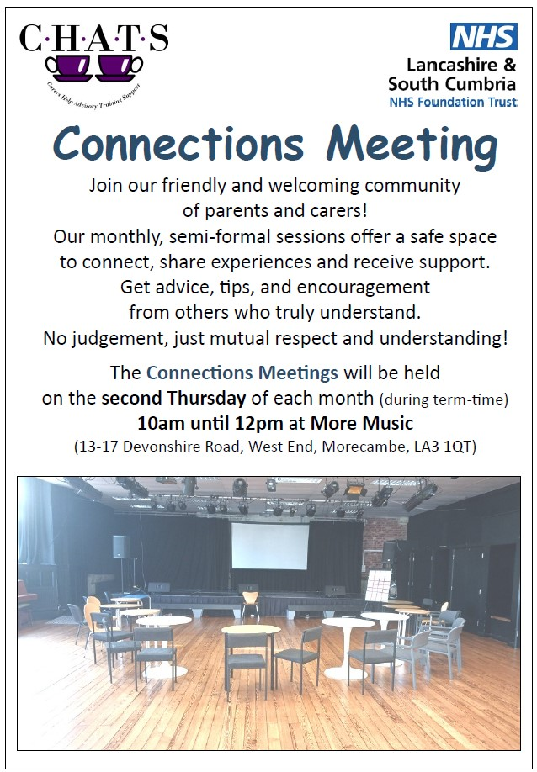
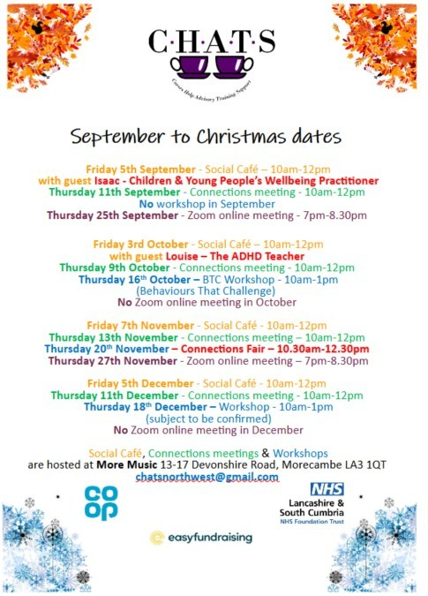

Slide 37

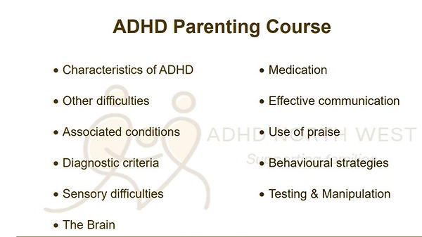
ADHD Support Service
www.adhdnorthwest.org.uk
01254 886 886 reception@adhdnorthwest.org.uk
Online and 1:1 consultancy with parents to provide information, guidance, and Support. Our whole family approach is tailored to meet each family’s individually identified difficulties and needs. Advocacy and emotional support is often provided for school issues, case meetings, and clinic appointments. Parenting Programme is designed to meet the needs of parents of children who are diagnosed or in assessment for ADHD

Slide 38

The Incredible Years
CAMHSCPS&ADHDService@lscft.nhs.uk
Tel: 01524 550 650
Referral Criteria:
Parent/carers of Children and young people aged 2-10
Be registered at a GP practice in the Morecambe Bay area
Referral by form from professional working with the family or parent/carer self referral via phone call.
Need support for Behaviours that challenge, The Incredible Years is an evidenced based programme which helps parents manage behaviour which challenges, including conditions such as ADHD. Often, these behaviours impact on the whole family, leaving everyone, including the child, feeling negatively about themselves. This course will improve your relationship with your child and increase yours, and your child’s, confidence.
Support Offer:
Group delivery in person over 15 weeks term time only

Slide 39


Break Time
www.lancashire.gov.uk/children-education-families/special-educational-needs-and-disabilities/things-to-do/break-time
0300 123 6720 ask for someone from Children and Family Wellbeing SEND team
breaktime@lancashire.gov.uk
Registration opens again in October Half Term 2024
Criteria:
Children will be able to access Break Time from the start of the academic year (September) in which they turn age 5 to the end of the academic year (July) in which they turn 18.
A child or young person has special educational needs and/or disabilities meaning they are unable to access universal services and activities; and the parent and carers are in receipt of child benefit for that child or young person.
Children will live in Lancashire (excluding Blackburn with Darwen and Blackpool council areas).
Break Time short break activities provide a range of activities and groups for children and young people with special educational needs and/or disabilities who meet the criteria to attend and who do not receive short breaks following a social care assessment of need.
Each eligible child or young person can access up to 78 hours of Break Time activities and groups each year which can be used between one or two Break Time providers.
There will be a minimum contribution from parents and carers towards Break Time activities and groups of £2 per hour. This is in addition to any specific costs for activities, entrance fees or transport costs to activities.

Slide 40

Unique Kidz and Co
www.uniquekidzandco.org.uk
info@uniquekidzandco.org.uk
Tel: 01524 831132
Woodhill Lane, Morecambe, LA4 4NW
Afterschool Club
After School Club is open 3:15pm to 6pm every weekday during term time for children aged 5 to 19 years old. We have two disabled access minibuses that collect children from the two local special schools and transport to our building or you can drop your children off with us yourself. Please get in touch for more information.
We are an approved Breaktime provider for our Afterschool Club and have 3 spaces available each evening. If you are a Breaktime member and would like to use your Breaktime hours for our Afterschool Club please get in touch.
Holiday Club
Also for children aged 5 to 19 years old, our Holiday Club provides a wide range of activities every weekday during school holidays (including Christmas!).
Siblings Group
We understand how difficult it can be for siblings to find the support they need so we have a Siblings Group with regular meetings . Open to all young people who have a disabled sibling, the group meets twice every month.
Our group provides a place for young people to come and have the space they may need with friends and staff who understand and can relate to their experiences. The group is all about the activities that the young people want to do – so far trips out have included going out for dinner, watching a show at the theatre and a night at Blackpool Illuminations!

Slide 41

Unique Toyz
www.uniquekidzandco.org.uk/toy-library
uniquetoyz01@gmail.com
Tel: 01524 831132
Woodhill Lane, Morecambe, LA4 4NW
Stay and Play
Our Stay and Play Sessions are open for both disabled children and their siblings, aged 0 to 5 years old. With a calm and fun atmosphere, both you and your children are sure to have fun!
Led and supervised by our highly qualified Play Workers, your children will learn play skills with a small group. The sessions are on Wednesdays and Thursdays, focusing on different aspects, such as social and motor skills, that are vital for children to acquire.
Wednesday Stay and Play Session (10:00 – 12:00)
This session provides a chance for an informal meeting with other parents. Come along to have a chat with people who can relate to your experiences whilst you enjoy a nice cup of tea and watch your children play.
Thursday Sensory Session (12:00 – 2:00)
Hands on and interactive, this session gives parents or carers time to spend with their children in our sensory room that helps to develop essential skills.
Unique Toyz Lending Library
Unique Toyz is a fully funded Toy Library for children up to the age of 18 who have disabilities and or additional needs in the Lancaster, Morecambe and the surrounding areas! You do not need to use any of Unique Kidz and Co.’s other services to become a member of the Toy Library. It is free to join the Toy Library. You will need to complete a membership form and read the terms and conditions before borrowing your first item.

Slide 42

4Ever Unique
www.uniquekidzandco.org.uk/4ever-unique
4ever@uniquekidzandco.org.uk
Tel: 01524 831132
Woodhill Lane, Morecambe, LA4 4NW
4Ever Unique
Our Daytime Support Service is a safe place for you to meet, make friends, experience new things and be yourself.
We are open five days a week between 9am and 6pm, 52 weeks of the year (excluding bank holidays). We also offer regular evening and weekend social sessions that young adults can attend.
Our disabled access minibus collects students from Beaumont College and the Grizedale Centre who would like to attend. If you would like more information please contact Sally Nelson by emailing 4ever@uniquekidzandco.org.uk.
We like to offer a wide range of activities at 4EVer Unique and are always looking at changing and developing our timetable to offer as much choice as possible to the young adults who attend. At the moment, our weekly timetable includes: equestrian training, gym sessions, network wheels at Salt Ayre, volunteering at a local charity shop, travel training and swimming. This is all on top of our regular in house activities that include baking/cooking, gardening, arts and crafts, sensory sessions and lots more!

Slide 43


Bee Unique Autism
www.beeuniquecharity.co.uk
Bookwhen.com/beeunique (events booking site)
beeuniquecharity@gmail.com
Charity set up to run activities, awareness events and training for families who have Autistic children. A non profit organisation to support SEN families. We are an award winning West Cumbria Based Charity. All SEN families welcome & you do not need an official diagnosis to attend sessions.
Activities on offer across Cumbria and Lancashire check the bookwhen link for details.
Coffee mornings to meet other parent carers run monthly. No need to book just turn up.

Slide 44
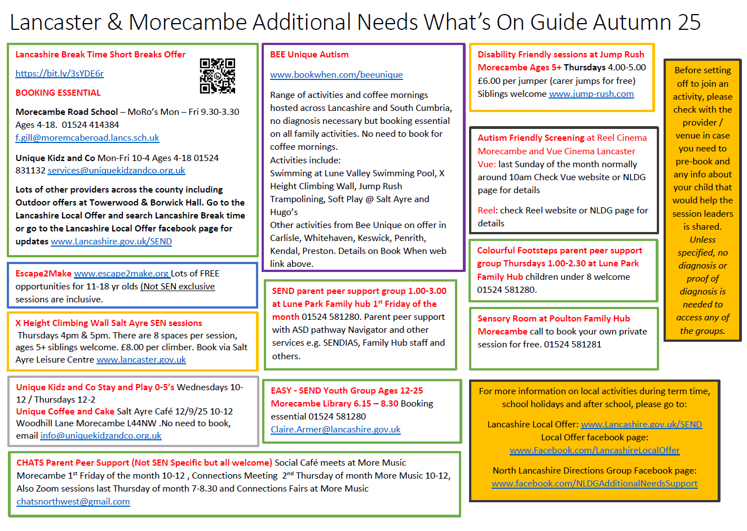
If there are other groups or services you think should be included on this guide please email LMChildAutism@lscft.nhs.uk

