Slide 1

Lancaster & Morecambe
Children’s Autism Assessment Team

Slide 2
Aims for this session:
Referrals to the Autism Pathway
What we look for
Referral routes
Autism Pathway Processes
Support whilst waiting for assessment
Post-diagnostic support
Q&A session

Slide 3

School Aged Autism Assessment Team
01524 550331
LMChildAutism@lscft.nhs.uk
Referral by form to Referral hub LDReferralHub@lscft.nhs.uk
Referral Criteria:
Children in Reception year at Primary School until December before their 16th birthday
Be registered at a GP practice in the Morecambe Bay area – check with team if unsure.
Referral by professional who knows the child/young person the best on Part A of the referral form. Part B from parent /carer is optional but helpful to aid discussion.

Slide 4
Process agreed with Lancaster Autism Assessment Team
Options for referral by professional who knows the child best:
OPTION A - Part A fully completed to be sent with Part B where available
OPTION B - Part A form completed with as much detail as possible including the demographics (the hub will need the demographics to open a referral). Complete a summary observation of Behaviour in the class room and during playtime to be submitted with the Part A.
Referral information to include the following:
Social interaction difficulties (e.g., limited peer relationships, eye contact, do they play alongside, lead play, take charge, follow others)
Communication challenges (e.g., literal language, delayed speech, response to praise or fear of failure)
Repetitive behaviours or routines (response to changes in routine, need for routines)
Sensory sensitivities (e.g., noise, textures, lights)
Emotional regulation issues (e.g., meltdowns, shutdowns, returning after school holidays)
Behavioural patterns across different settings or with different staff (classroom, playground, PPA time – how do they respond if there are teacher changes with or without warning etc.)
Professional Input details where applicable
Educational Psychology involvement – EP reports, SEN Support / EHCP
Speech and Language Therapy reports
CAMHS or paediatrician input
Other relevant assessments or reports – are they / have they been known to CFW / CSC if so, why?

Slide 5

What if school don’t see the same difficulties as described by parents / carers? Contact the team for a case discussion, encourage the parent to complete the Part B.
Advice offered to school to:
Take some time to observe them in the classroom and at play and consider whether they could be masking / following / controlling play or conversations.
Ask a colleague to observe them for you and see if they notice anything else.
Ask the parent to complete the Part B of the referral form to submit with your observations to the team.
What happens next
The team will review the referral form and any other reports that are available and consider whether there is enough for an initial assessment (further information gathering).
The team don’t expect you to have enough evidence to warrant a diagnosis at this stage, that is for the Autism assessment team to decide.

Slide 6

If accepted for further assessment
Questionnaire links sent to parent/carer and school once parent/carers have responded to the letter following triage (3-week deadline for response then 3-week deadline for questionnaire completion)
Information reviewed to consider if a full assessment is needed – within 12 weeks currently.
If there is any doubt as to whether a full assessment is needed (not enough information, widely different information from home and school), the team will do their own observation (school / clinic / home).
If team decide there isn’t enough evidence for full assessment
Following school or clinic-based or home observation, report created, and parents contacted to explain outcome. Case then discharged.

Slide 7

If team decide a full assessment is needed
Added to final stage waiting list for Multi Disciplinary Team(paediatrician / psychologist, LD Nurse, SALT) observation / ADOS & Autism Diagnostic Interview
Current wait times for this stage is 3 years due to funding
What happens after the assessment
Full report given to explain the outcome, appropriate signposting offered.
Family Connect and This Is Me - opt in services then discharged.
The team are only commissioned to complete Autism assessments; there is no ongoing support following assessment conclusion

Slide 8
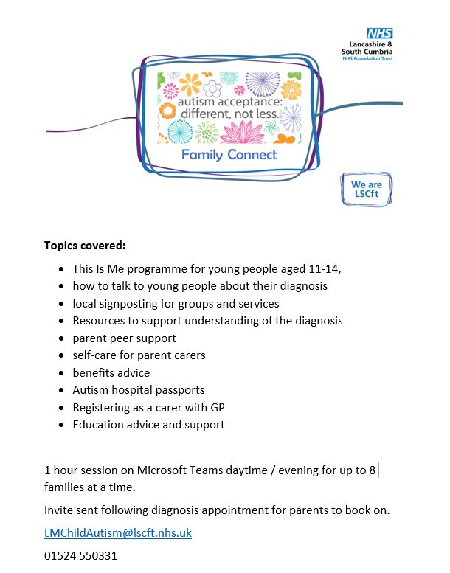
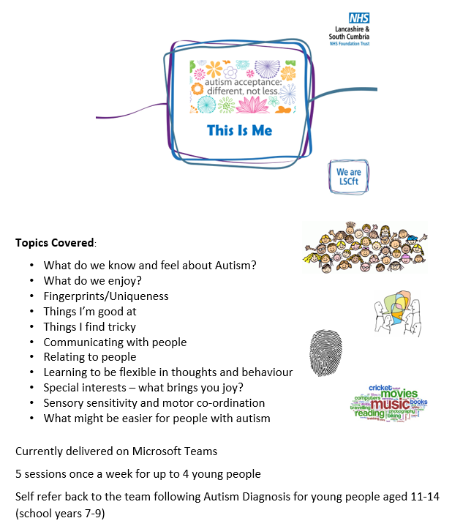

Slide 9
Support for families whilst waiting for assessment
Signposting
- Lancashire Local Offer, North Lancashire Directions Group, Lancaster CVS Directory
Mental Health support
- Kooth, Barnardo’s Thrive, CAMHS, ACE Counselling.
Understanding and managing behaviours
- Lancashire Mind, Triple P, Incredible Years, ADHD Northwest
Support to understand access to Education, Health and Social care services including EHCP processes
- Lancashire Parent Carer Forum, Lancashire SENDIAS
Parent peer support
- In person groups (CHATS, Lune Park Family Hub SEND Support Group, Unique Kidz and Co), Social Media groups
Children and Young People support and groups
- Bee Unique, Colourful Footsteps, Inside Out, Lancashire Break Time, Unique Kidz and Co, EASY, POWAR, Stanleys , Prop Up Social Ease, Escape 2 Make
Family Hub offer
- Coffee and Connect, Colourful Footsteps, EASY
Other services and Complex cases
- Social prescribers, GP Case Discussions, Learning Disability Team

Slide 10
Signposting

Slide 11




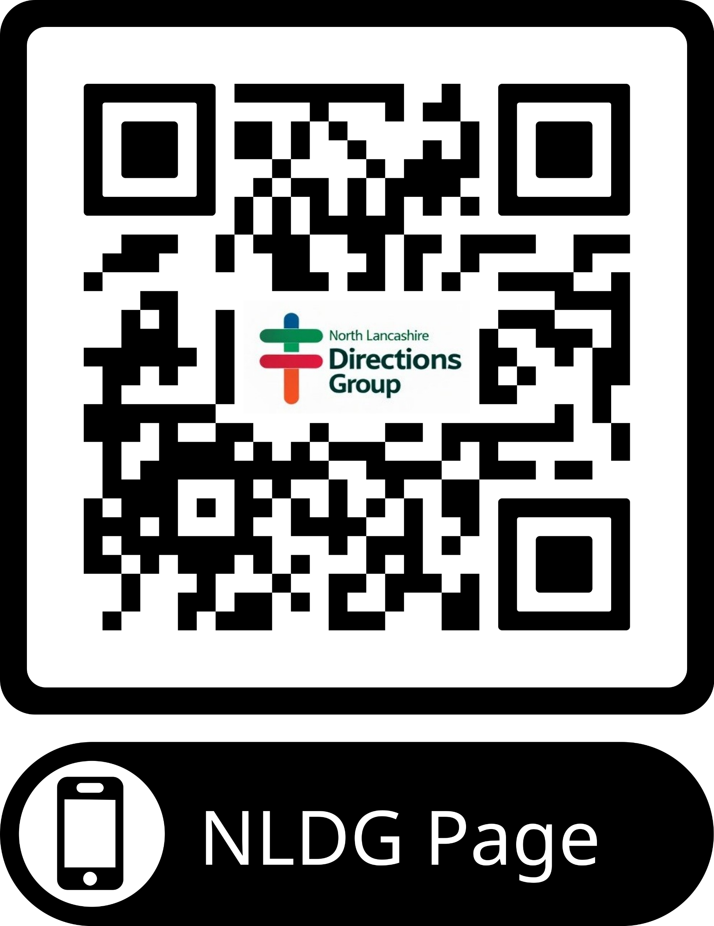




CYP Support offer PowerPoint regularly cascaded with updated information – also on NLDG website home page to download
Lancashire Local Offer
www.Lancashire.gov.uk/SEND
North Lancashire Directions Group
www.northlancashiredirectionsgroup.com
Lancaster District CVS Directory
https://directory.lancastercvs.org.uk/

Slide 12
Mental Health Support

Slide 13

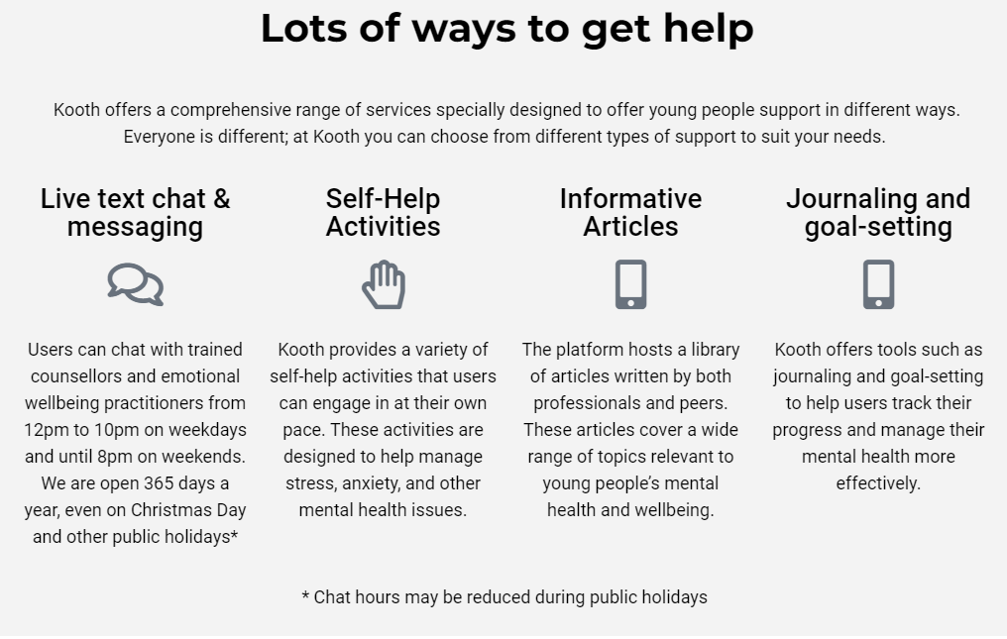
Kooth
Mental Health Support
www.Kooth.com

Slide 14

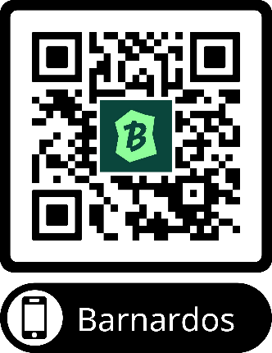
Lancashire and South Cumbria Thrive Service
Mental Health Support Service
01772 505138 thrivelsc@barnardos.org.uk
www.barnardos.org.uk/get-support/services/lancashire-and-south-cumbria-thrive-service
The service offers therapeutic one-to-one, group work and counselling support to children and young people aged 5 to 18 (extending to 25 years based on SEN need) within the whole of the Lancashire & South Cumbria Integrated Care Board (ICB) area.
Please note: The My Time to THRIVE Service is NOT a crisis service. We provide support to children & young people with low – moderate mental health needs. Services supporting children and young people's emotional health and wellbeing. We have centres where children and young people can visit and have a trained worker they can trust and talk to. We help them build their confidence and get to the root of their difficulties.
If you need urgent support, please contact your GP, the local CAMHS Crisis Team (via 0800 953 0110) or in an emergency situation, you should consider contacting Emergency Services or visit your local A&E department or Urgent Care facility.
Here are some other services and organisations, that may also be useful to you:
www.kooth.com
www.youngminds.org.uk
www.every-life-matters.org.uk

Slide 15
CAMHS/CPS (Child Psychology Service)& ADHD Team
Harvey House Lancaster
01524 550650
Request for Involvement (RFI) - Complete all sections of the LSCFT referral and Appointment Centre-RFI form
(same RFI form for CAMHS/ CPS / ADHD— indicate which service you are requesting)
Return forms to C&F.ReferralCentre@lancashircare.nhs.uk or lcn-tr.cfreferralcetre@nhs.net
Advice and guidance
Refer to Mental Health Champions Toolkit
Contact the Primary Mental Health Workers based at CAMHS email PMHWLancasterandMorecambe@lscft.nhs.uk
ADHD Referral Criteria: (refer to Top Tips Guide) – referral is for assessment and diagnosis then medication if warranted.
Children aged 6 +. Be registered at a GP practice in the Morecambe Bay area
Referral by professional who knows the child/young person the best. The team need details of intention, hyperactivity, impulsivity - specific examples of each of these areas of difficulty is helpful for the team
Details of emotional dysregulation is important too — behavioural and/or attention problems suggestive of ADHD, severity of the problems, how this affects the child or young person and the parents/carers, the extent to which they impact different parts of their day to day life.
A period of watchful waiting has identified issues in the young person’s day to day functioning which indicates a need for further assessment—the referral should state the issues and what has been identified

Slide 16
Understanding & Managing Behaviours

Slide 17
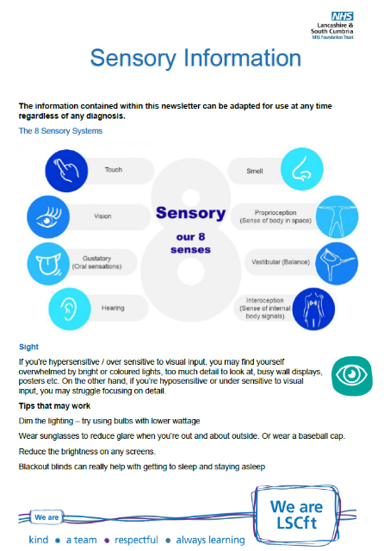


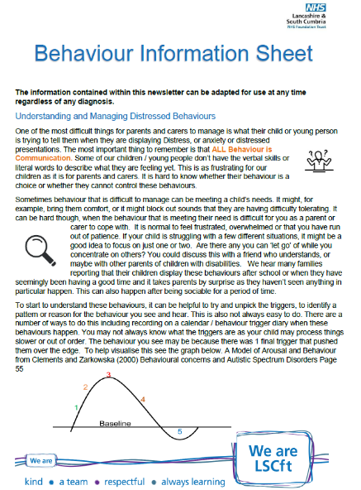
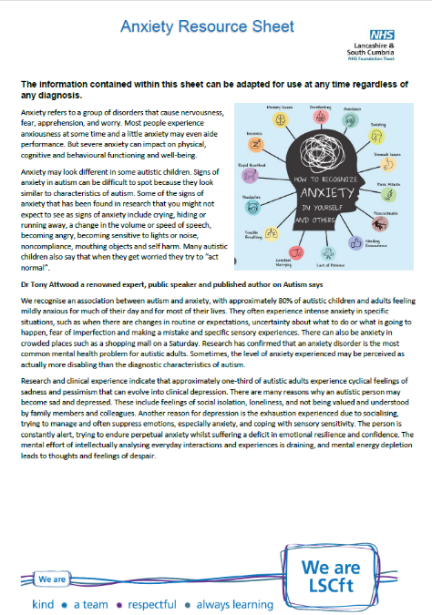
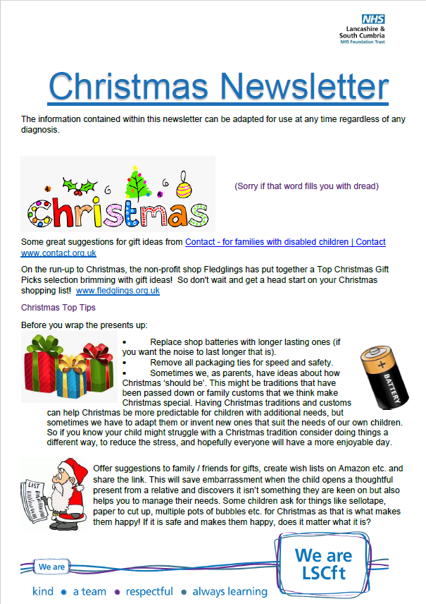
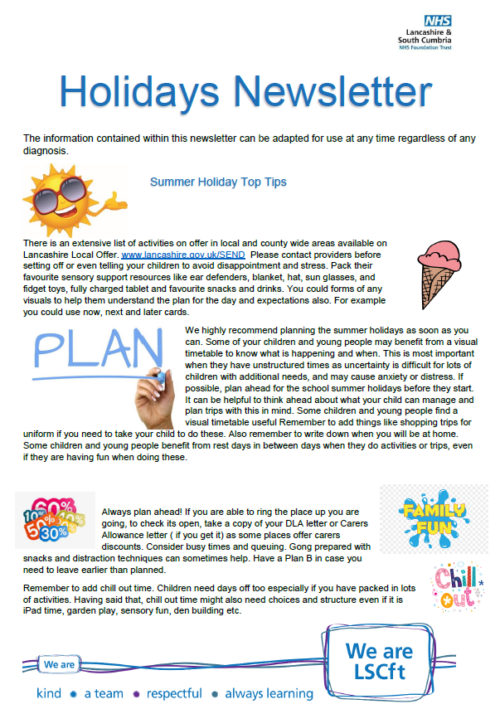
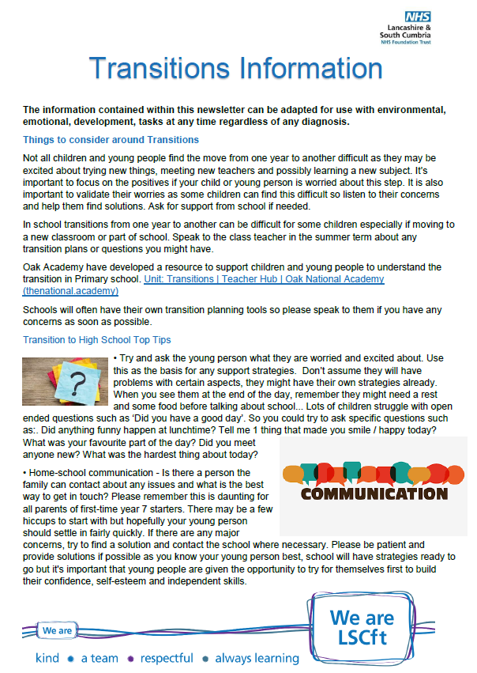
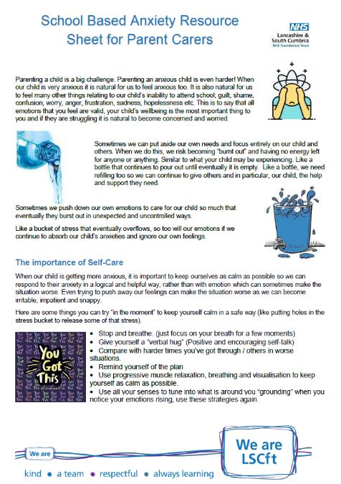

Slide 18

Free Lancashire Mind course on Mental Health and neurodiversity called Supporting Your Child
Training for Parents
Supporting Your Child with emotional wellbeing and/or neurodiversity. A course for parents looking for tools and strategies to support the emotional health and wellbeing of their child.
www.trainingondemand.lancashiremind.org.uk
More information/video intro: https://www.youtube.com/watch?v=CXM2fnTiWhI
It is offered at no cost. It is for anyone interested in supporting mental wellbeing in their children but includes information specifically about mental wellbeing and neurodiversity (ADHD, autism, dyslexia and related mental differences). It has been created based on feedback from professionals, parents and those who are neurodivergent and/or who have had difficulties with their mental wellbeing.
There is a downloadable support kit at the end of the training full of practical ideas to support you and your child.
You can register and enrol here: https://trainingondemand.lancashiremind.org.uk/
Learning Objectives
Improve basic knowledge around neurodiversity
Understand the importance of mental health
Learn tools and techniques to support emotional wellbeing and self esteem
Recognition of the importance of communication and family cohesion
Disclaimer: This is not a specific mental health or neurodiverse diagnoses course. This is not a course for parents whose children or parents/carers who are in crisis. Both mental health and neurodiversity are broad spectrums of experience. This course is intended to provide parents and carers with tools and techniques to maintain communication and family cohesion, whilst navigating the challenges of parenting and the journey of seeking support. Difficult thoughts and feelings have intentionally been omitted to ensure that all our learners feel safe and supported throughout the session. For more information on our 'live' parenting workshops supported by trained facilitators, which do tackle more challenging topics, please contact training@lancashiremind.org.uk.
If your child is in crisis, please reach out to local NHS support by calling 999 for urgent support or contacting 111 (select 2) for non urgent support or speak to your GP.

Slide 19


Referral Criteria:
Parent/carers of Children and young people aged 0-16
Referral by professional working with the family or parent/carer self referral.
Support Offer:
Group delivery in person over 15 weeks term time only
Group Triple P (8 Weeks) consists of:
5 group sessions (2 hours each)
3 individual phone conversations (20-30 mins)
Group Triple P is suitable for parents with concerns about their child’s behaviour or who wish to learn a variety of parenting skills that will promote their child’s development and potential.
Stepping Stones Group (9 Weeks) consists of:
6 group sessions (2.5 hours each)
3 individual phone conversations (20-30 mins)
Group Stepping Stones is suitable for parents/caregivers of children with a range of additional needs (e.g. intellectual disability, autism spectrum disorders, cerebral palsy, waiting on assessment) who wish to learn a variety of parenting skills that will promote their child’s development and potential.

Slide 20

The Incredible Years
CAMHSCPS&ADHDService@lscft.nhs.uk
Tel: 01524 550 650
Referral Criteria:
Parent/carers of Children and young people aged 2-10
Be registered at a GP practice in the Morecambe Bay area
Referral by form from professional working with the family or parent/carer self referral via phone call.
Need support for Behaviours that challenge, The Incredible Years is an evidenced based programme which helps parents manage behaviour which challenges, including conditions such as ADHD. Often, these behaviours impact on the whole family, leaving everyone, including the child, feeling negatively about themselves. This course will improve your relationship with your child and increase yours, and your child’s, confidence.
Support Offer:
Group delivery in person over 15 weeks term time only

Slide 21

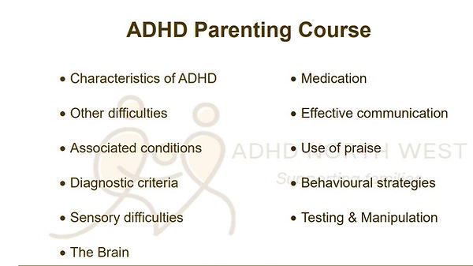
ADHD Support Service
www.adhdnorthwest.org.uk
01254 886 886 reception@adhdnorthwest.org.uk
Online and 1:1 consultancy with parents to provide information, guidance, and Support. Our whole family approach is tailored to meet each family’s individually identified difficulties and needs. Advocacy and emotional support is often provided for school issues, case meetings, and clinic appointments. Parenting Programme is designed to meet the needs of parents of children who are diagnosed or in assessment for ADHD

Slide 22
Support to understand access to Education, Health and Social care services including EHCP processes

Slide 23


Lancashire SENDIAS
www.lancssendias.org.uk
0300 123 6706 (Mon-Fri 9am-5pm)
Information.lineteam@lancashire.gov.uk
Provide a service for children and young people with special educational needs and disabilities, aged up to 25, and their parents or carers. We give support around SEND issues at every stage of a child’s education, including into further education and adulthood. The service offers: signposting, printed and online information, email / phone information and advice, face to face support
We will:
aim to respond to your enquiry within two working days (depending on capacity)
help you to express your views and resolve issues
assist with paperwork relating to EHCP’s where needed
maintain information provided on a secure and confidential database
provide telephone advice and information
meet with you, if required
attend meetings with you, if needed
maintain confidentiality, in accordance with local safeguarding procedures
We will not:
contact other people on your behalf without your prior consent
pass your information on to other organisations without your agreement
make decisions on your behalf
attend meetings or provide reports in your absence
provide transport to/from meetings (except in exceptional circumstances)

Slide 24



Lancashire Parent Carer Forum
lancashireparentcarerforum.org.uk
This is open to all parent carers of a child or young adult who is living with additional needs and/or disabilities, whether diagnosed or not from 0-25 years and who live in or receive services from the county of Lancashire.
Being a member of a Parent Carer Forum involves getting involved in the work of the forum, sharing your experiences, and helping to improve services for children and young people with special educational needs and/or disabilities (SEND). It's about collaborating with local authorities and other organisations to ensure services are effective and meet the needs of families.
Next round of Webinar series of Lets Talk Events from Lancashire Parent Carer Forum and Lancashire SEND partnership Lancashire Parent Carer Forum Events - 6 Upcoming Activities and Tickets | Eventbrite https://www.eventbrite.co.uk/.../lancashire-parent-carer...
Transitions and Preparation for Adulthood – Presentations from Social Care and Health
Tues 11th Nov 7pm, Weds 12th Nov 10am, Fri 14th Nov
Supported Internships – Presentation from SEND Employment Officer
Mon 24th Nov 11am, Tues 25th Nov 7pm, Thurs 27th Nov 1.30pm

Slide 25
Parent Peer Support

Slide 26



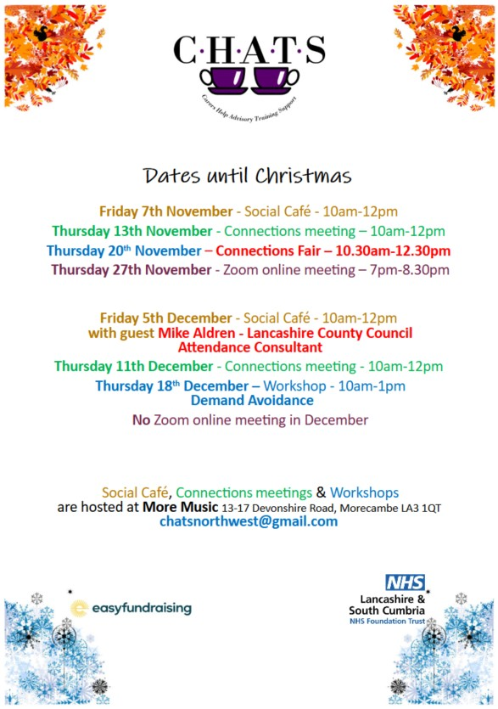
Support whilst waiting
Autism Pathway Navigator
Employed as lived experience staff member to provide support and signposting to parent carers and referrers whilst they wait for assessment. 01524 550331 LMChildAutism@lscft.nhs.uk

Slide 27
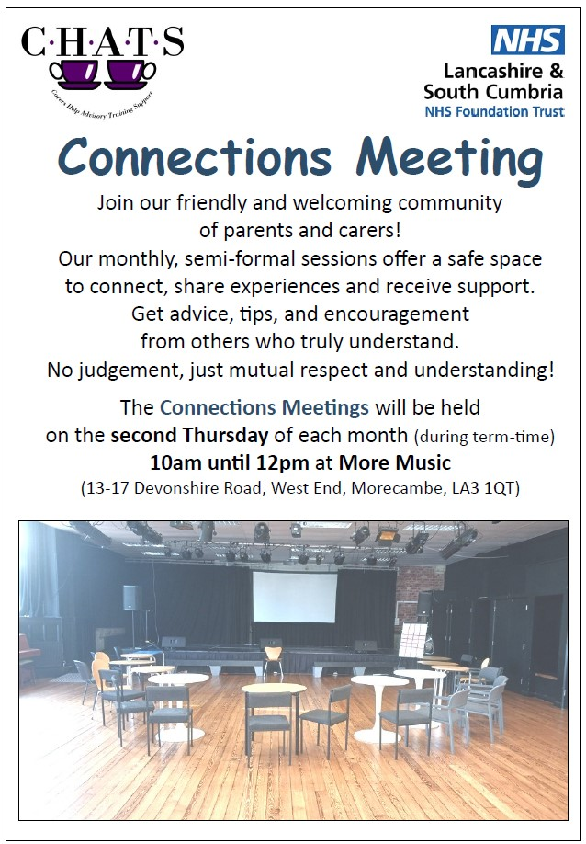
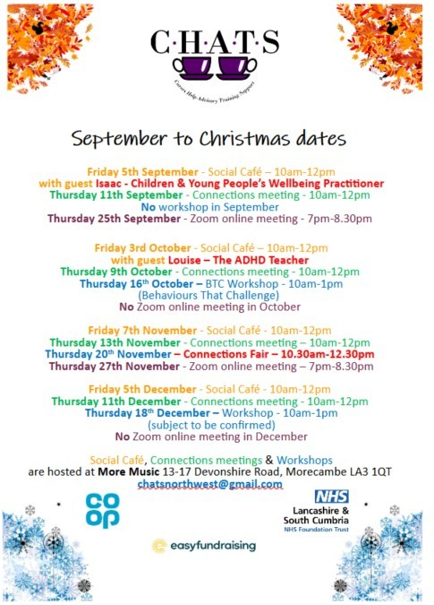


Slide 28


Unique Toyz
www.uniquekidzandco.org.uk/toy-library
uniquetoyz01@gmail.com
Tel: 01524 831132
Woodhill Lane, Morecambe, LA4 4NW
Stay and Play
Our Stay and Play Sessions are open for both disabled children and their siblings, aged 0 to 5 years old. With a calm and fun atmosphere, both you and your children are sure to have fun!
Led and supervised by our highly qualified Play Workers, your children will learn play skills with a small group. The sessions are on Wednesdays and Thursdays, focusing on different aspects, such as social and motor skills, that are vital for children to acquire.
Wednesday Stay and Play Session (10:00 – 12:00)
This session provides a chance for an informal meeting with other parents. Come along to have a chat with people who can relate to your experiences whilst you enjoy a nice cup of tea and watch your children play.
Thursday Sensory Session (12:00 – 2:00)
Hands on and interactive, this session gives parents or carers time to spend with their children in our sensory room that helps to develop essential skills.
Unique Toyz Lending Library
Unique Toyz is a fully funded Toy Library for children up to the age of 18 who have disabilities and or additional needs in the Lancaster, Morecambe and the surrounding areas! You do not need to use any of Unique Kidz and Co.’s other services to become a member of the Toy Library. It is free to join the Toy Library. You will need to complete a membership form and read the terms and conditions before borrowing your first item.

Slide 29



Slide 30
Children & Young People Support

Slide 31





Slide 32







Slide 33

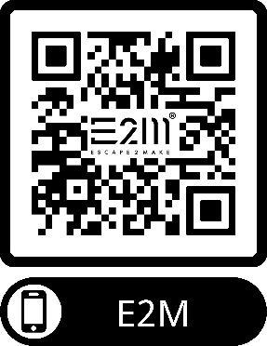
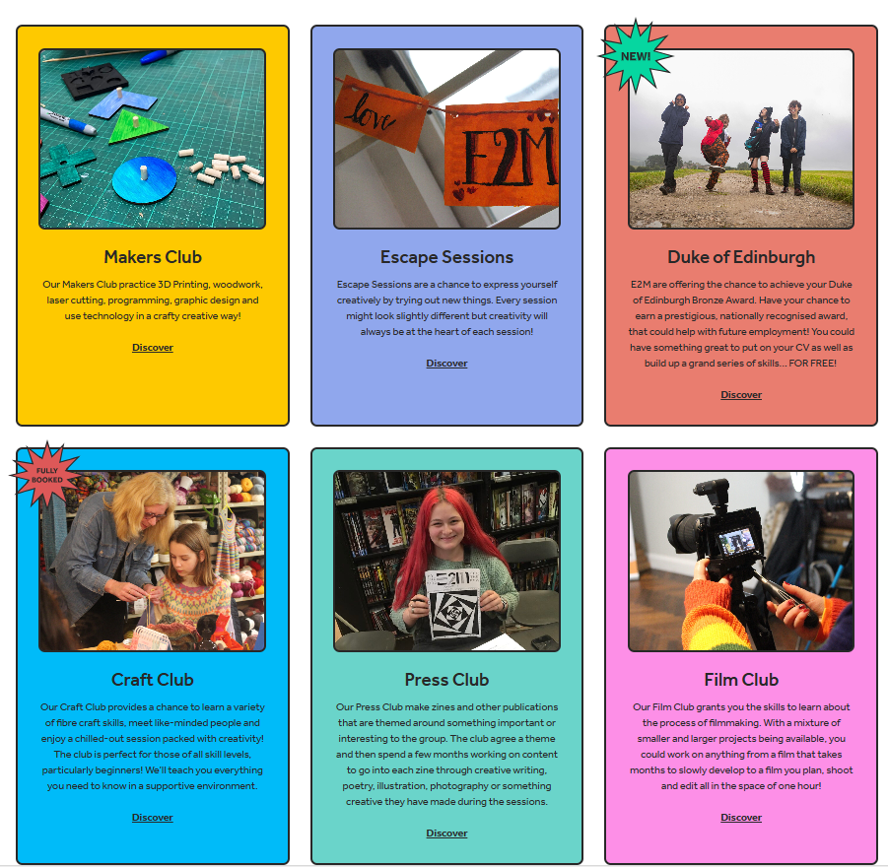
escape2make.org
E2M is a Charitable Incorporated Organisation (Registered Charity Number 1183572) that aims to help 11-18s, from all walks of life in the Lancaster & Morecambe area to escape from boredom, social media, loneliness and any pressure at school or home by providing free creative activities. E2M create safe, kind, welcoming spaces through its creative clubs and 5-week programs that result in community events (such as festivals, cabarets, fairs and markets) that are hosted by local artists and local businesses. All the activities are inclusive and free and designed to help young people make things, make friends and make a difference in the community.

Slide 34

Bay Medical Group Young People’s Social Prescribers
www.baymedicalgroup.co.uk/bay-icc-enquires
www.baymedicalgroup.co.uk/young-persons-social-prescribers
Our Young Person’s Social Prescribing Service is delivered in partnership with Stanley’s Community Centre and More Music. The Young Persons Social Prescribers can accept referrals for people from age 11 and up to and including people aged 19 who are registered with Bay Medical Group.
Social prescribing can help support people to: make lifestyle changes, connect with groups and activities in the community and includes supportive personalised conversations to help improve health and wellbeing.
Our Young Persons Social Prescribers will make contact with the young people and arrange to meet at an agreed community venue or provide telephone support. We aim to work with young people to understand what matters to them and provide support to empower young people to reach their goals and potential.

Slide 35
Lancashire Mind Peer Support Programme
www.lancashiremind.org.uk/project/childrens-peer-support/
North Lancashire Contact charlottesutton@lancashiremind.org.uk
Through innovative, peer-led support systems, this programme aims to enhance the mental health and wellbeing of young people aged 10 to 19 (up to 25 with SEND) across Lancashire. With children facing an alarming increase in mental health challenges, we can help support them to find coping strategies and build resilience.
Our Peer Support Programme is run across Lancashire. The project offers multiple routes for young people to access the support they need, tailored to their individual wellbeing needs. The key elements of the programme include wellbeing assessments, diverse support routes, and the training of community peer support mentors.
Support Available
The initiative addresses the growing prevalence of mental health issues among young people. We deliver a range of wellbeing provisions within the programme, including:
1:1 Peer Support Wellbeing Coaching (virtual sessions)
Support to access existing community groups
Signposting to specialist support
Peer support training
Establishing new groups for young people

Slide 36
Support Routes:
Route A – Social Prescribing:
A social prescribing approach is used to signpost the young person into existing services.
Support is provided as needed over a 2-month period.
Route B – Targeted Peer Support Groups
Attendance at or creation of a specifically targeted peer support group.
Groups may focus on LGBTQIA+, looked-after children, racialised communities, neurodiverse-specific needs, young carers, etc.
Route C: Wellbeing Coaching
For young people not ready to attend a group setting.
Wellbeing coaching involves a 6-week, 1-to-1 coaching intervention through Lancashire Mind.
Route D: Specialist Support Services
Our support coordinator refers the young person into other specialist support services, such as ADHD support, addiction support, debt management, etc.

Slide 37
Family hubs

Slide 38

Find local services
https://events.apps.lancashire.gov.uk/w/webpage/all-events?service=ALL
Lune Park Family Hub
Ryelands Park, Owen Road,
Lancaster,LA1 2LN
Email: lancasterfamilyhub@lancashire.gov.uk
Telephone: 01524 581280
The Children and Family Wellbeing Service (CFW) offers a wide range of support across the 0-19yrs+ age range (25 years for SEND) with a 'whole family' approach.
The service identifies as early as possible when a child, young person or family needs support, helping them to access services to meet their needs, working with them to ensure the support offered is right for them, is offered in the right place, and at the right time.
The main focus of the service is to provide an enhanced level of support to individual children, young people or families with higher levels of need. Service resources are prioritised towards identified priority target groups or individuals at risk who are assessed using Lancashire's www.lancashire.gov.uk/practitioners/supporting-children-and-families/early-help-assessment/ as having more complex or intensive needs.
Coffee and Connect at Morecambe Library for families to seek advice from a range of services.
1st Thursday of the month 9.30-11.30 pre school children welcome.
Coffee and Connect at Carnforth Family Hub Sept 13th, 20th, 27th (Oct dates TBC) 1.30-3.30

Slide 39
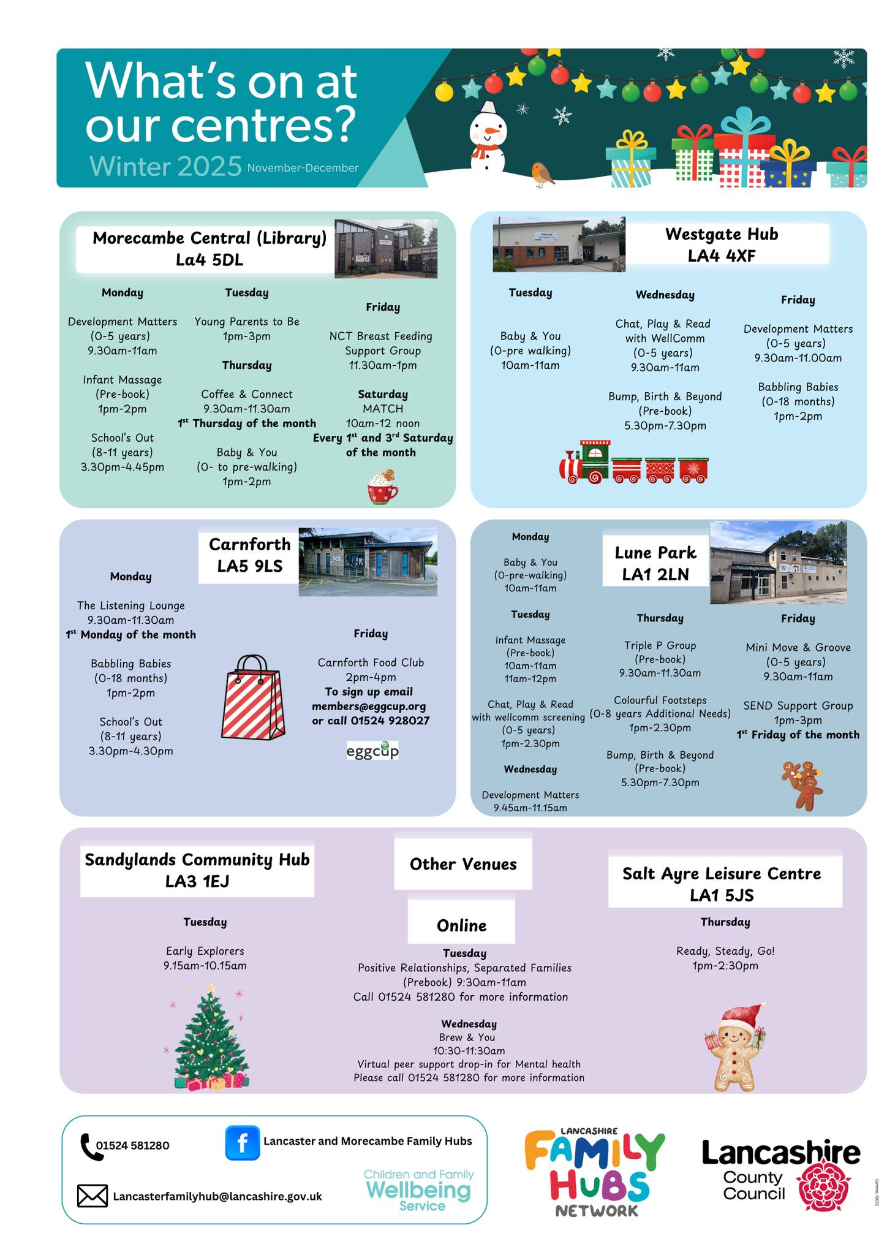

Slide 40
Post-diagnostic Support

Slide 41


Resources to support understanding of the diagnosis
www.autism.org.uk/advice-and-guidance/topics/resources-for-autistic-teenagers
The Know Yourself series is a set of free resources which includes videos and downloadable guides aiming to support you and others like you to understand what being autistic means.
In the resources you'll hear from young autistic people talking about their experiences and what has helped them. The aim is to offer information and ideas that will empower you to begin to explore your own experiences and understand yourself more.
The series will cover six topics in total over the course of three years. First 2 are below
Energy Accounting Guide (Similar to Spoon theory)
National Autistic Society Know Yourself series (thirdlight.com)
Know Yourself Guide – list of resources including booked and videos to support understanding
Know Yourself other resources.pdf (thirdlight.com)
www.autism.org.uk/advice-and-guidance/topics/diagnosis Information, practical and multimedia resources about how autistic people and their families may feel after a diagnosis and the support that may be available.
What is Autism videos and resources
www.ambitiousaboutautism.org.uk/information-about-autism/understanding-autism/what-is-autism
Some new resources have been launched on the Ambitious about Autism website to support understanding behaviour. Quality of life at home toolkit | Ambitious about Autism

Slide 42

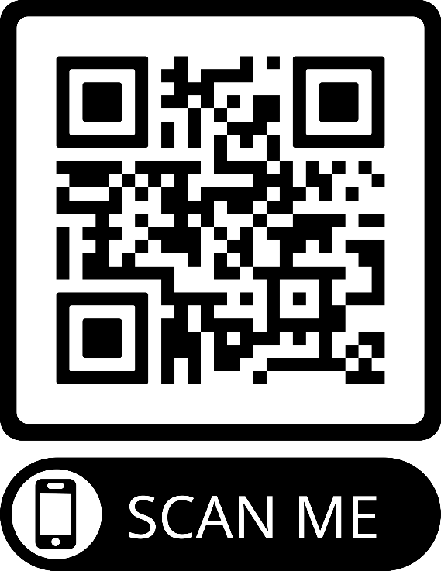





www.autism.org.uk/advice-and-guidance/topics/resources-for-autistic-teenagers

Slide 43
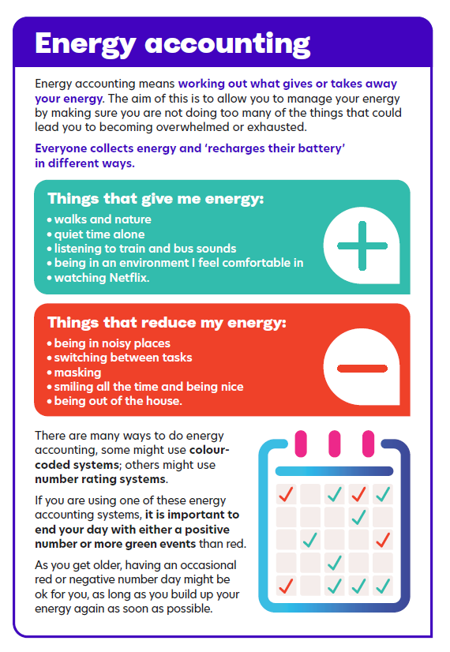

Slide 44
Check your pack of resources that was sent to you with the Diagnosis report for useful links including:
‘Amazing things happen’ you tube clip about ASD
https://www.youtube.com/watch?v=RbwRrVw-CRo
Inside our Autistic Minds BBC Two - Inside Our Autistic Minds
Paddy McGuinness documentary – Our Family and Autism
https://www.bbc.co.uk/iplayer/episode/m00122vl/paddy-and-christine-mcguinness-our-family-and-autism
Discover together what brings them JOY! As long as it’s safe and can be done in a safe and responsible way, let them continue with their passion. We all have things that make us happy and brings us joy. Encourage them to try new things or revisit old passions to find their “thing”.

Slide 45

www.pandasonline.org
NeuroBears (recommended by Anna Freud Organisation) is a course all about the autistic experience developed for, and in collaboration with, autistic young people. Aimed at young autistic people aged 8-14 who are new to understanding their autism. Through NeuroBears we hope to educate and increase young people’s understanding of their autistic experience and encourage them to share how they experience their autism with safe adults.
Neurobears has approximately 90 minutes of videos, broken down into 12 video sessions. The course is accompanied by young person and adult workbooks. License for home use is £75
The topics covered are:
A brief history of autism
A positive strengths-based diagnosis model. Autism Myths
Neurodivergence - Autism + environment = outcome
What autism isn’t – co-occurring conditions
Autism and sensory experience
Autistic overwhelm, meltdowns, and shutdowns. Autistic communication Autistic Masking. Spoon Theory and Autistic burnout. Autistic identity. Examples and personal experiences

Slide 46

www.lmc.ac.uk/courses/a-z-courses/understanding-autism-level-2
Understanding Autism - Level 2
Over the 8 - 12 weeks you will be required to complete a series of mandatory units.
Unit 1: Common traits and diagnosis of Autism Spectrum Disorder
This unit will provide you with an understanding of autistic spectrum conditions, the dyad of impairments and the importance of professional diagnosis of autism spectrum conditions. (Please note: This unit discusses Autism diagnosis using levels which is not something the NHS use in this area for diagnostic purposes)
Unit 2: Sources of information, support, legislation, and guidance relevant to Autism Spectrum Conditions
This unit covers the legislation and guidance relevant to autism spectrum conditions and helps you to understand ways to support individuals on the autism spectrum. This unit will also help you to understand the help and support available for individuals with autism spectrum disorder.
Unit 3: Living with Autism Spectrum Conditions
This unit covers the effect autism spectrum conditions have on an individual’s sensory experiences, the impact those conditions have on the family of an individual on the autism spectrum and the societal impact on individuals on the autism spectrum. This unit will also help you to understand the impact of the physical environment upon individuals on the autism spectrum.
Unit 4: Best practice relating to Autism Spectrum Conditions
This unit covers the experience of living with autism, how to support individuals to maintain their personal safety and the purpose of positive risk-taking. This unit will also help you to know how to support individuals with transitions, life events, accessing services and facilities and how to support individuals with employment.
On completion of this course you will receive a Level 2 Certificate in Understanding Autism, from TQUK.

Slide 47

www.beyondautism.org.uk/courses/an-introduction-to-autism-a-course-for-parents-families-and-carers/
Receiving a diagnosis of autism for a child, sibling or family member can be a confusing time. You may be seeking more information about what this means for the individual and their future. Or you may simply want to know how you can help.
This free course is designed to introduce what autism is, and provide information on key topics. This introductory course guides you through the full autism journey—from diagnosis, through transitions, and onto adulthood. Designed specifically for parents, families, and carers of autistic people, it covers essential topics such as communication, sensory needs, and behaviour, while also signposting you to valuable support networks.
With a completion time of approximately 2–4 hours, this course offers practical, useful insights into what autism means for individuals and their future.
For a range of downloadable resources go to the resource hub www.beyondautism.org.uk/resource-hub/

Slide 48
SENDIAS Independent Advice and Support Service Lancashire can offer unbiased advice and support when accessing Education, health and social care services. Offer advice and potentially can support in meetings with schools to be your advocate if you need that kind of support. Self refer via form on website. www.lancssendias.org.uk 0300 123 6706 information.lineteam@lancashire.gov.uk
Lancashire Local Offer
Website: https://www.lancashire.gov.uk/children-education-families/special-educational-needs-and-disabilities/ Local Offer Facebook page: https://www.facebook.com/LancashireLocalOffer
Lancashire County Council SEND Newsletters www.lancashire.gov.uk/children-education-families/special-educational-needs-and-disabilities/getting-help/send-newsletter/
Contact Listening Ear Service contact.org.uk/help-for-families/listening-ear/
Listening Ear service offers hour-long 1-1 telephone appointments with a family support adviser.
Where the helpline provides information and advice, Listening Ear is for parent carers looking for emotional support and reassurance – though we can provide practical help too. Bookable slots via website.
Young Minds Parent Helpline supports parents and carers who are concerned about their child or young person's mental health. They can provide detailed information and advice, emotional support and signposting. You can speak to them over the phone or chat online via website link. When closed, you can still leave a message and they’ll get back to you in 3-5 working days.
Opening times: 9.30am-4pm on Mondays, Thursdays and Fridays; 9.30am-6pm on Tuesdays and Wednesdays 0808 802 5544 www.youngminds.org.uk/parent/parents-helpline/

Slide 49
Now your child / young person has a diagnosis, you might want to consider doing the following things:
Completing a hospital passport for them in case they ever need to go into hospital. This will enable any staff supporting you and your child / young person to know about any sensory or physical adjustments that might make the experience more successful.
www.uhmb.nhs.uk/get-involved/patient-experience/care-and-communication-passports
Making an application for DLA Disability Living Allowance if under 16 or PIP Personal Independence Payment for young people over 16. A diagnosis isn’t essential to make an application, but it can help.
More information can be found on this link
https://www.northlancsdirectionsgroup.com/benefits-advice
Other benefits are available after DLA awarded like www.gov.uk/carers-allowance
additional Universal Credits/ Tax Credits.
Grant funding from www.familyfund.org.uk
As a parent / carer of a child / young person with an ASD diagnosis, you should register yourself as a carer with your GP. This should allow you some adjustments when asking for appointments and requesting support. Adjustments vary by practice. You will also be offered Flu and COVID jabs as a carer.

Slide 50
Complex cases & things to consider

Slide 51
Transition planning
Primary to Secondary School
Extended Transition Period
  Start planning early (Year 5 or 6).
  Offer phased visits, including during quieter times.
Detailed Handover
  Share comprehensive information: learning styles, emotional regulation strategies, triggers, and accommodations.
  Ensure SENCO-to-SENCO communication.
Orientation & Familiarisation
  Provide maps, timetables, and photos of key areas (classrooms, toilets, canteen).
  Practice navigating the school to reduce anxiety.
Staff Training
  Ensure secondary staff understand the pupil’s needs, including sensory and social differences. Create a one-page profile with the young person and family.
Support for Increased Complexity
  Plan for changes in routine, multiple teachers, homework expectations.
  Use planners or digital tools for organisation.
Social & Emotional Support
  Identify safe adults and spaces.
  Offer peer mentoring or transition groups.
Gradual Exposure
  Start with small group visits, then increase to full-day experiences.
  Include opportunities to meet form tutors and key staff.
Monitoring & Review
  Schedule check-ins after transition (first few weeks and termly).
  Adjust support as needed.

Slide 52
School Attendance Difficulties in Autism
Autistic students may experience heightened anxiety related to school routines, sensory environments, or social interactions.
Difficulties often stem from challenges with transitions, unpredictability, and changes in routine.
Co-occurring conditions (e.g., ADHD, anxiety disorders) can exacerbate attendance issues.
Emotional regulation difficulties can lead to avoidance behaviours when overwhelmed.
Identifying Barriers
Sensory Overload: Bright lights, uniform, loud noises, crowded spaces can cause distress.
Social Challenges: Peer interactions, bullying, or lack of understanding from staff.
Communication Difficulties: Struggles expressing needs or discomfort.
Academic Pressure: Fear of failure or misunderstanding of expectations.
Environmental Factors: Unclear routines, sudden changes, or lack of safe spaces.
Mental Health: Anxiety, depression, or school-related trauma.
Addressing Barriers
Collaborative Approach: Work with parents, SENCO, and mental health professionals.
Individualized Support Plan: Include reasonable adjustments and clear strategies.
Predictability & Structure: Visual schedules, clear routines, and advance notice of changes.
Sensory Accommodations: Quiet spaces, noise-cancelling headphones, flexible seating.
Social Support: Peer buddies, social skills groups, anti-bullying measures.
Gradual Reintegration: Phased return plans with achievable goals.
Communication Tools: Use visual aids, social stories, and alternative communication methods.
Staff Training: Autism awareness and strategies for emotional regulation.

Slide 53

Lancaster Paediatric ICC MDT Meetings for case discussions. Monthly Thursdays 2.45pm via Teams
Lancaster Integrated care community (ICC) and primary care network facilitate a monthly multidisciplinary team meeting (MDT) for children and young people. The MDT occurs monthly on a Thursday from 2.30pm and is held online. The MDT is chaired by Ceri Hurst Clinical Leader, Community Children's nursing team
Input from a GP at Lancaster Medical Practice. Regular core members include; Child and Adolescent Mental Health services, Children and Families Wellbeing service, Community children's specialist nurses, Autism pathways navigator and paediatricians as appropriate.
Cases to be discussed must have tried all other avenues for support first to ensure staff time for discussion is used appropriately.
To make a referral for discussion at the MDT please gain consent from the family first then email Ceri.Hurst@mbht.nhs.uk

Slide 54
BAY ICC MDT Meetings for case discussions. Weekly on Thursdays 2pm via Teams
Bay Integrated care community (ICC) and primary care network facilitate a weekly multidisciplinary team meeting (MDT) for children and young people. The MDT occurs every Thursday from 2-3pm and is held online. The MDT is chaired by GP at Bay Medical group. Regular core members include; Child and Adolescent Mental Health services, Children and Families Wellbeing service, Community children's specialist nurses, social prescriber for young people, Autism pathways navigator and paediatricians as appropriate. Other services specific to cases being discussed will be invited to attend e.g. Police, Children's Social care etc.
The MDT provides an excellent opportunity to have access to a range of services, specialists, knowledge and support for people working with young people who are registered with Bay Medical group. As an MDT group we are keen to ensure that our colleagues in education are aware of this support available and how to access if appropriate. Cases to be discussed must have tried all other avenues for support first to ensure staff time for discussion is used appropriately.
To make a referral for discussion at the MDT please seek consent from the family first then email Alison.Scanlon1@mbht.nhs.uk and in the first instance she will liaise with you to answer any questions that you may have about the process.

Slide 55

Consider the parents potentially being Neurodiverse themselves.
Neurodevelopmental Pathway Re-Design updates via ICB website – see QR code
Ages 16+ - Adults pathway referrals via GP with completed AQ-10 from google.
Right To Choose referrals vs Local pathway vs Private providers
LSC Integrated Care Board :: Neurodevelopmental pathway
ARFID (Avoidant Restrictive Food Intake Disorder) - The Birmingham Food Refusal Service - Birmingham Food Refusal Service
What it’s Like to Live with ARFID | Eating Disorders | YoungMinds
PDA (Pathological Demand Avoidance) PDA Society - Pathological Demand Avoidance

Slide 56
Self Care resources for teens
Personal care | Autism Central
Supporting neurodivergent children with personal care - Family Action

Slide 57
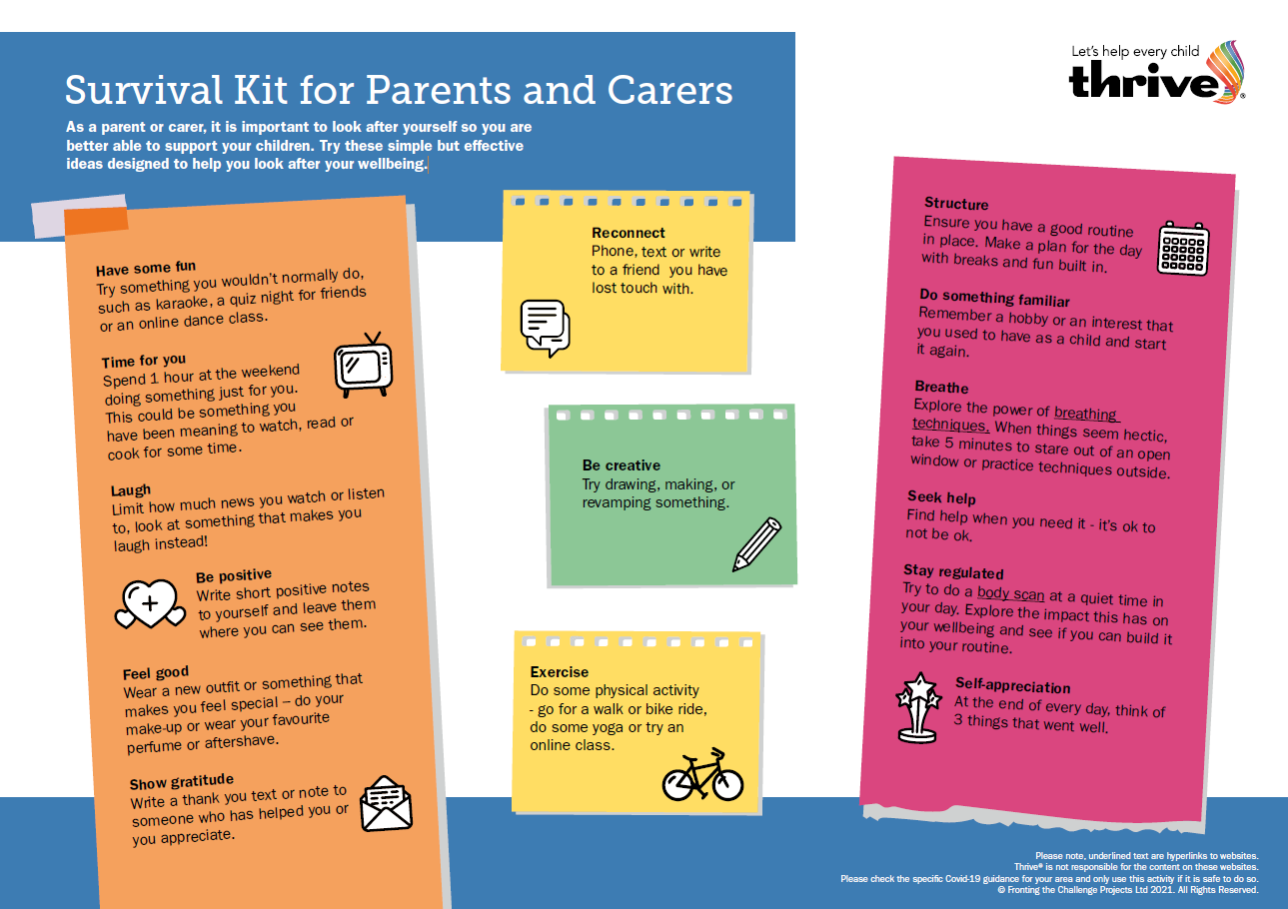

Slide 58


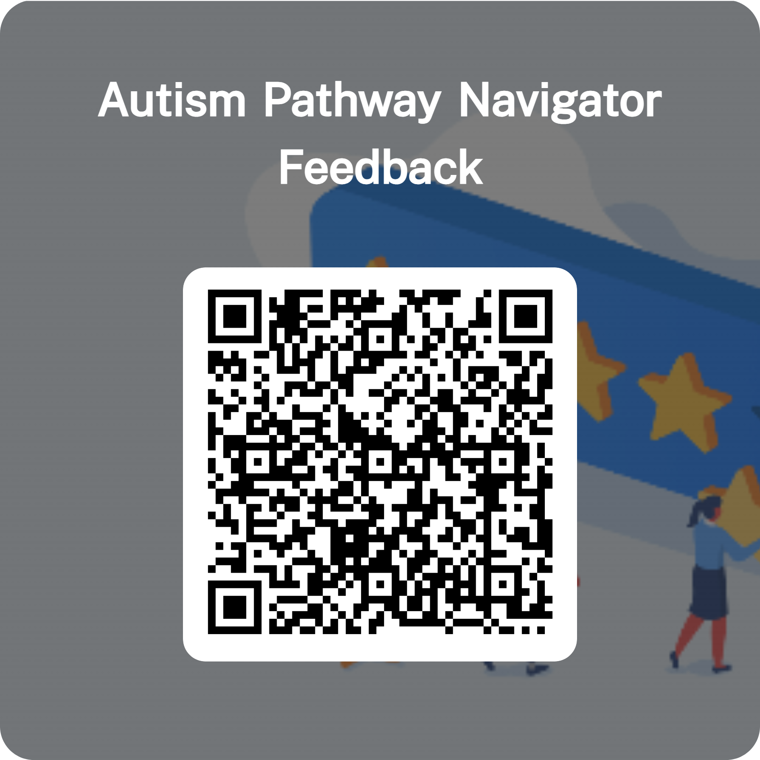
LMChildAutism@lscft.nhs.uk
01524 550331
Autism Pathway Navigator Feedback – Fill in form

